Slide 1
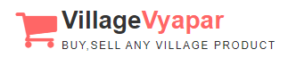
Web-application for,
Village Vyapar
“Buy, Sell and Find just about Village Product (c2c)”

Slide 2
INDEX
No. | Content | Slide No.
1 | Group Information
1.1 | Existing System
1.2 | Need for the New System
1.3 | Objective of the New System
1.4 | Core Components
1.5 | Customer Panel
1.6 | Project Profile
1.7 | Assumptions and Constraints
1.8 | Advantages and Limitations of the Proposed System

Slide 3
2 | Requirement Determination & Analysis
2.1 | Requirement Determination
2.2 | Targeted Users
3 | System Design
3.1 | Use Case Diagram
3.2 | Class Diagram
3.3 | Interaction Diagram
3.4 | Activity Diagram
3.5 | Data Dictionary

Slide 4
4 | Development
4.1 | Coding Standards
4.2 | Screen Shots
5 | Proposed Enhancements
6 | Conclusion
7 | Bibliography

Slide 5
Group Information :
GROUP NO : 04
Full Name | Enrollment No
Raja Himani Yatin | 205160694004
Chauhan Zeel Jitendrakumar | 205160694009
Parmar Devansh Rajeshbhai | 205160694023
Lashkari Parth Ashokbhai | 205160694029
Internal Faculty : :
Prof. Alka Patel

Slide 6
1
INTRODUCTION

Slide 7

Existing System :
Existing system is trading between people through calls,
and middle man therefore it is limited geographically.

Slide 8


Need for the New System :
The geographical limitation stops the business from growing and hence a lot of products do not get much attention.
It is difficult to account for the sales.
Cost of product is increased as middle man is included also
there is thin profit margin

Slide 9
Objective of New System :
This system allows to directly communicate via chat board so customer and
seller can negotiate on suitable price.
To increase the sales of the current small scale village businesses.
To provide multiple source of the same products which ensures that the
customer gets the desired quality product.
Cost of product is reduced as middle man is eliminated.
Customer can view products in any native language.

Slide 10
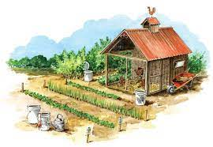
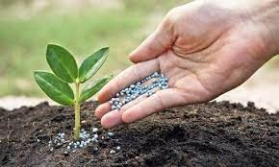
Project Definition :
This project is aimed at developing a web application that depicts online shopping of village products such as
food, Animals feed, Handicraft etc.
This web application also allows customer to
sell the product and others can purchase or vice versa
(i.e. Customer to Customer).
It provides a communication medium via chat board.

Slide 11




Core Components :
Admin
Customer
Visitor

Slide 12
Admin
Login
Manage Profile
Manage Customers
Manage Category & Sub category
Manage Products
Manage Inquiry
Manage Feedback
Generate Reports

Slide 13
Customer
Login
Manage Profile
Search Rural Product
View Categories & Sub Categories
View Rural Product in multiple language
Chat with Seller/Buyer
Inquiry
Feedback
Manage Inquiry
Manage Product
Manage Wishlist

Slide 14
Visitor
Registration
Search Rural Product
View Rural Product
View Feedback & Rating

Slide 15
Project Profile :

Slide 16
Assumptions & Constraint :

Slide 17
Advantages of Proposed System :

Slide 18
Disadvantage of Proposed System :

Slide 19
2
Requirement Determination & Analysis

Slide 20
Software Requirement :

Slide 21
Hardware Requirement :

Slide 22
3
System Design

Slide 23
Use Case Diagram

Slide 24
Class Diagram

Slide 25
Interaction Diagram

Slide 26
Activity Diagram

Slide 27
Data Dictionary

Slide 28
4
Development

Slide 29
Coding Standard :

Slide 30
Screen Shot (Customer)

Slide 31

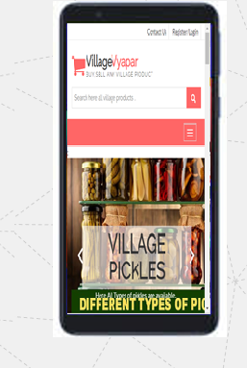
Requirement Determination

Slide 32
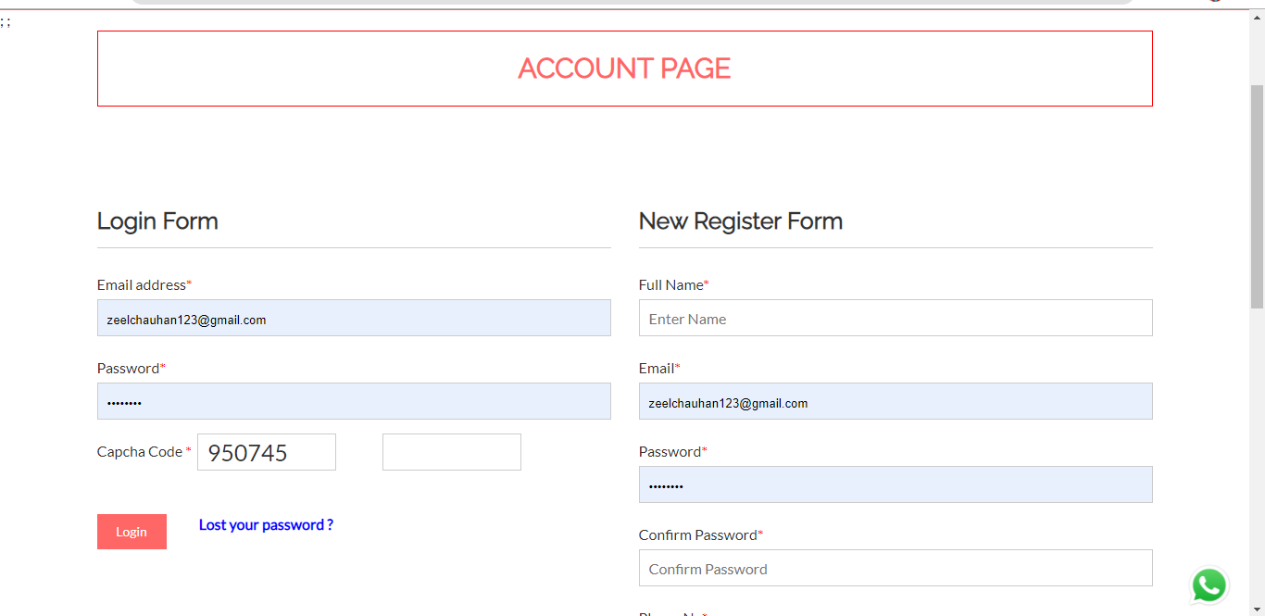
Login and Registration page

Slide 33
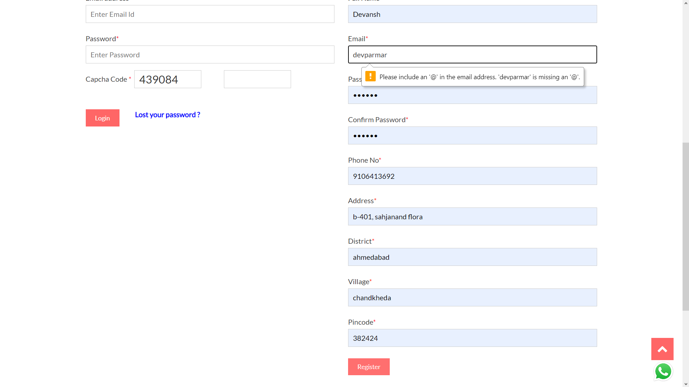
Registration with invalid credentials

Slide 34
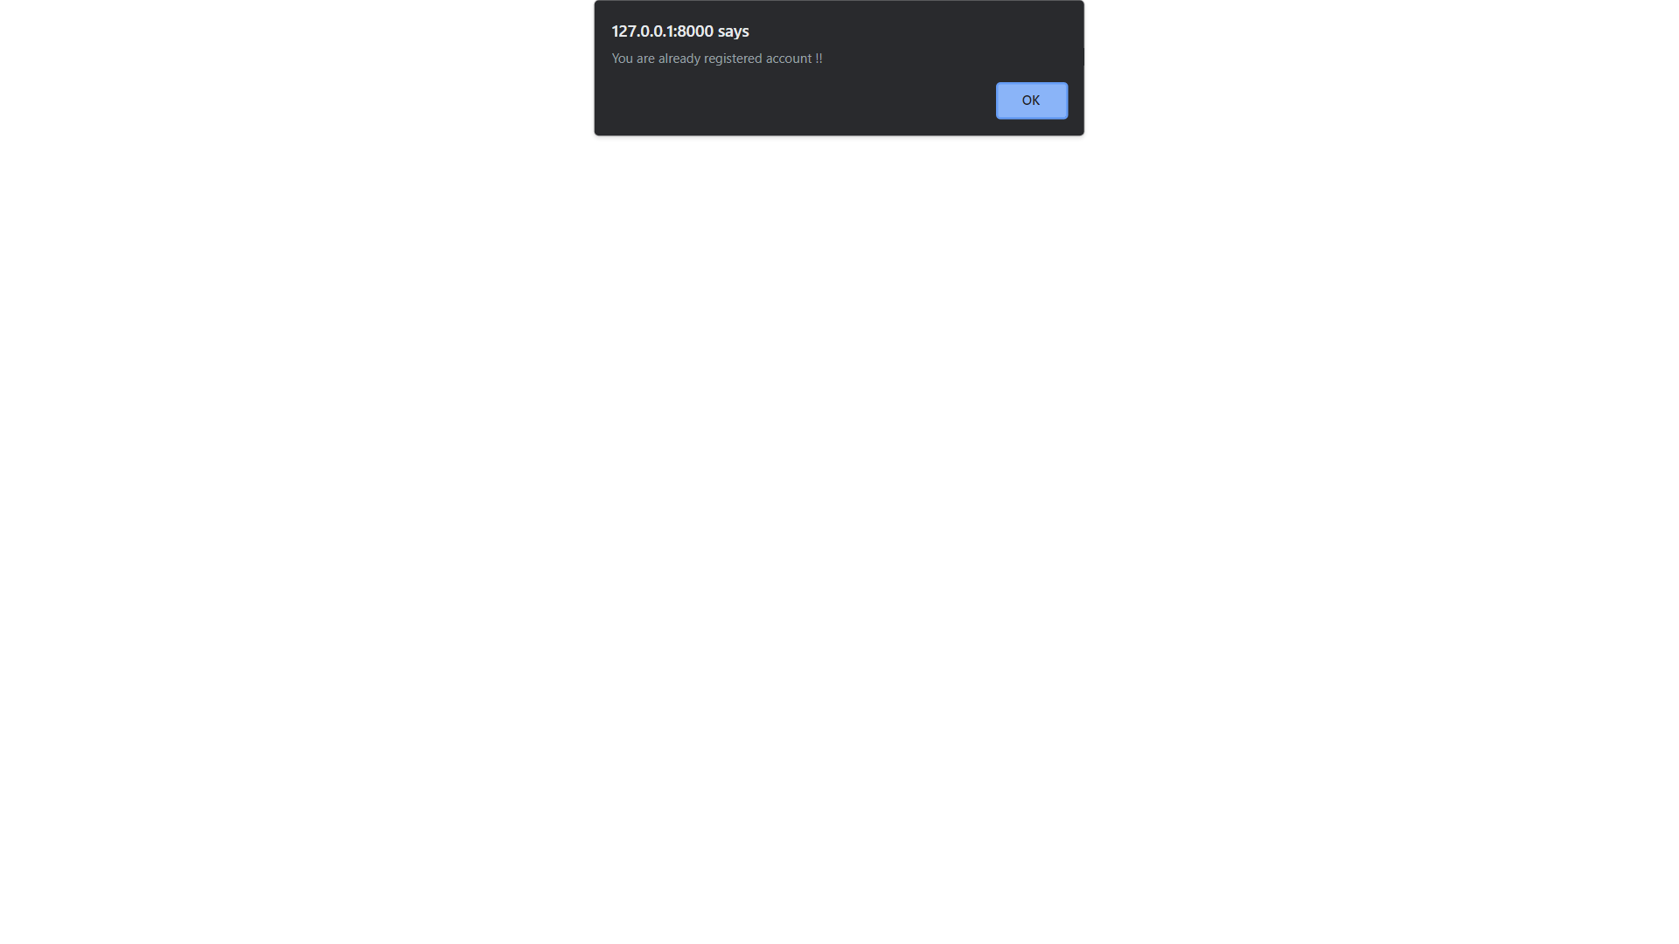
Registration with existing email

Slide 35

OTP sent at email on New Registration

Slide 36
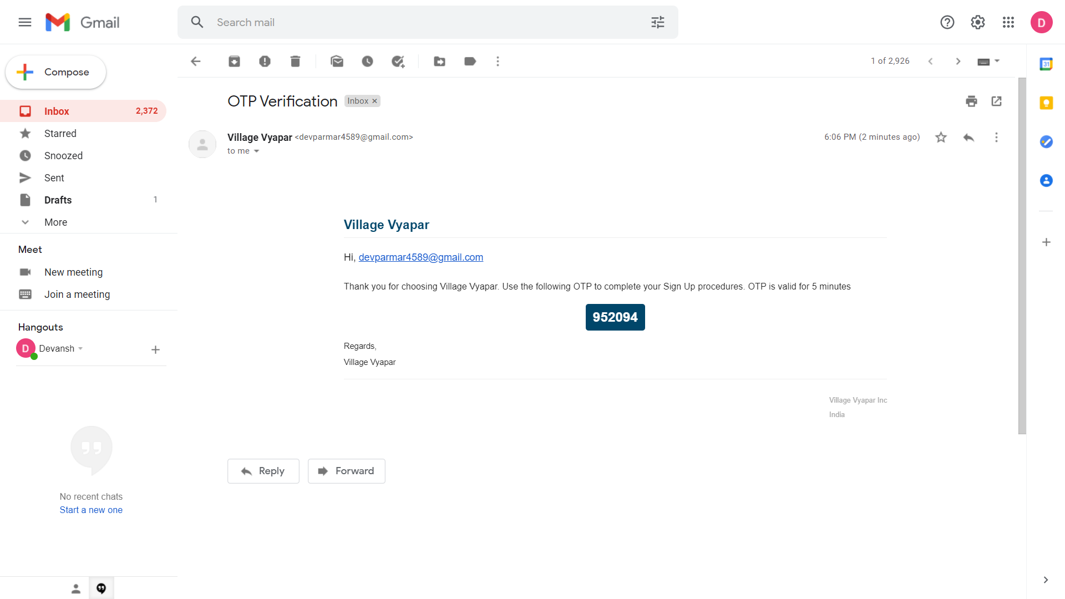
OTP sent at email on New Registration

Slide 37
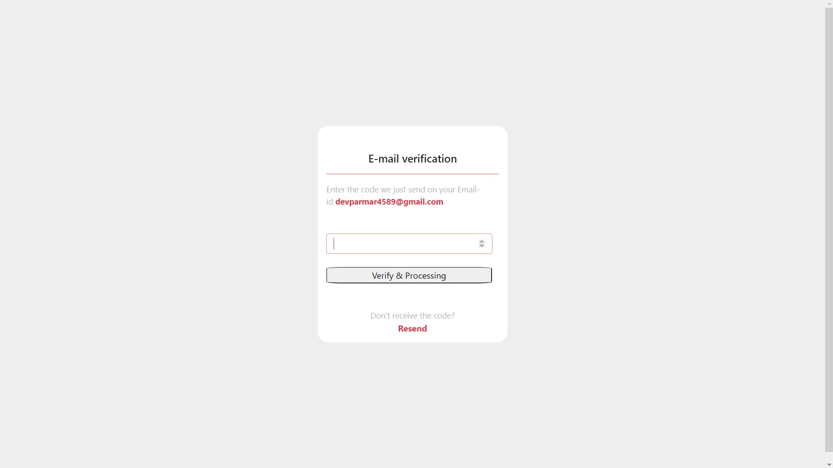
Confirm OTP sent at email

Slide 38
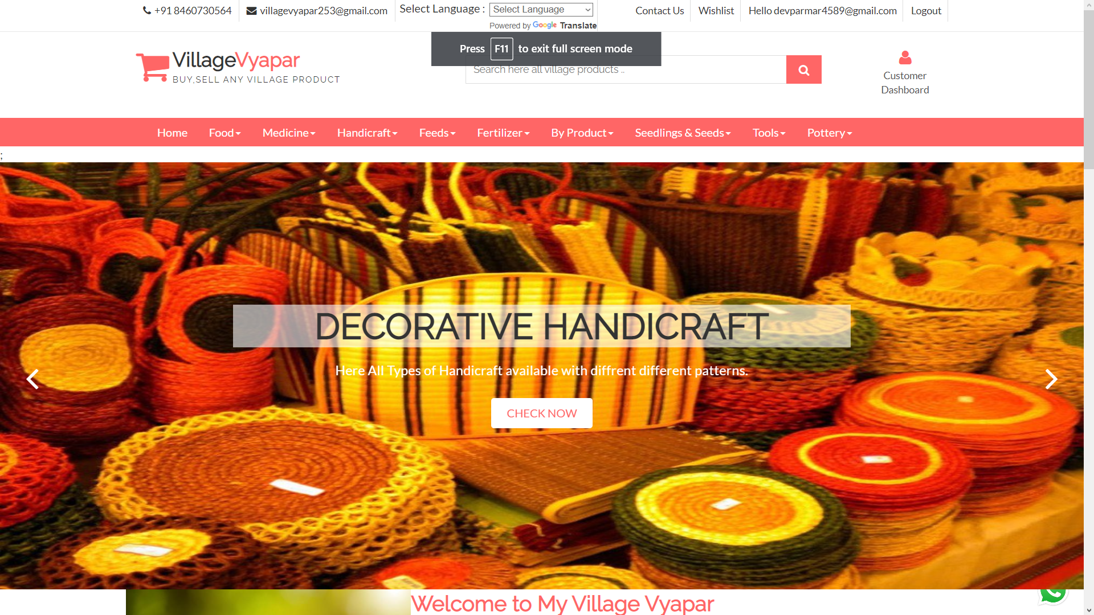
Homepage after Registration and login

Slide 39

Login with invalid credentials

Slide 40
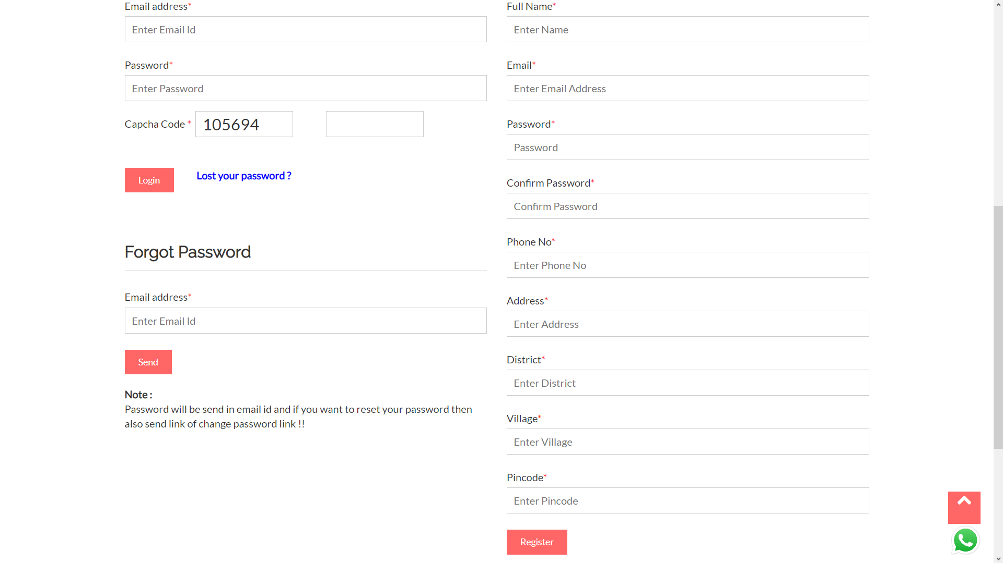
Forgot password

Slide 41

Lost password sent at email address

Slide 42
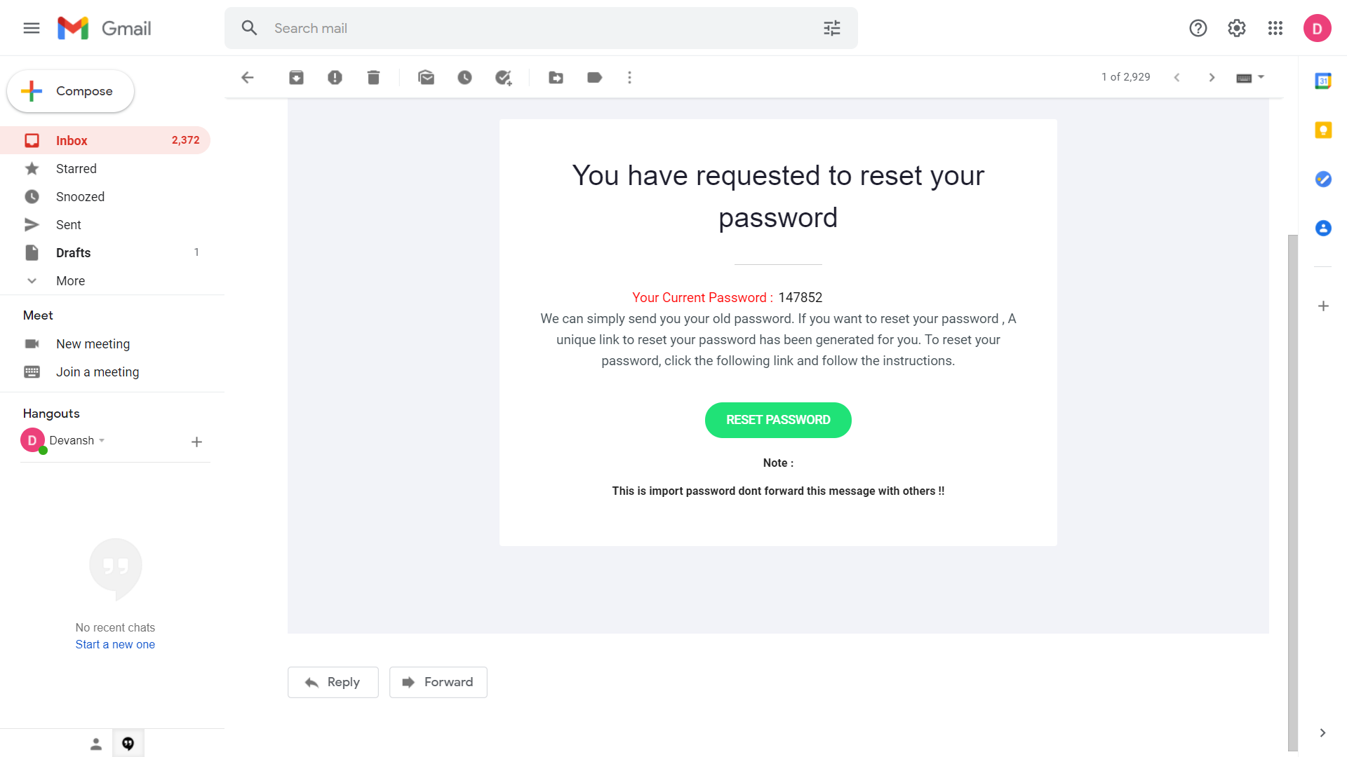
Email sent for lost password

Slide 43
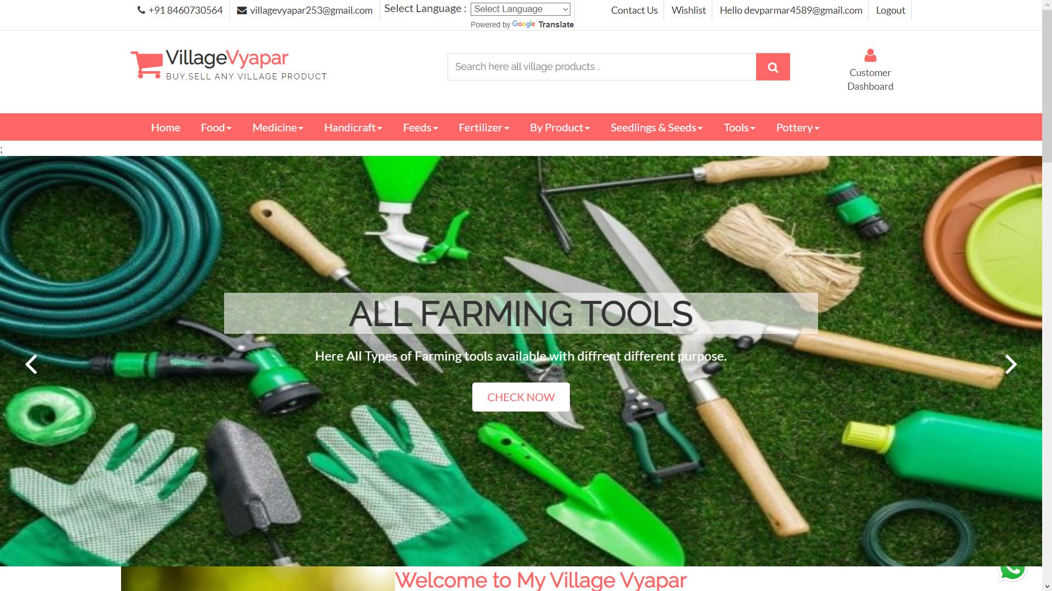
Welcome page

Slide 44
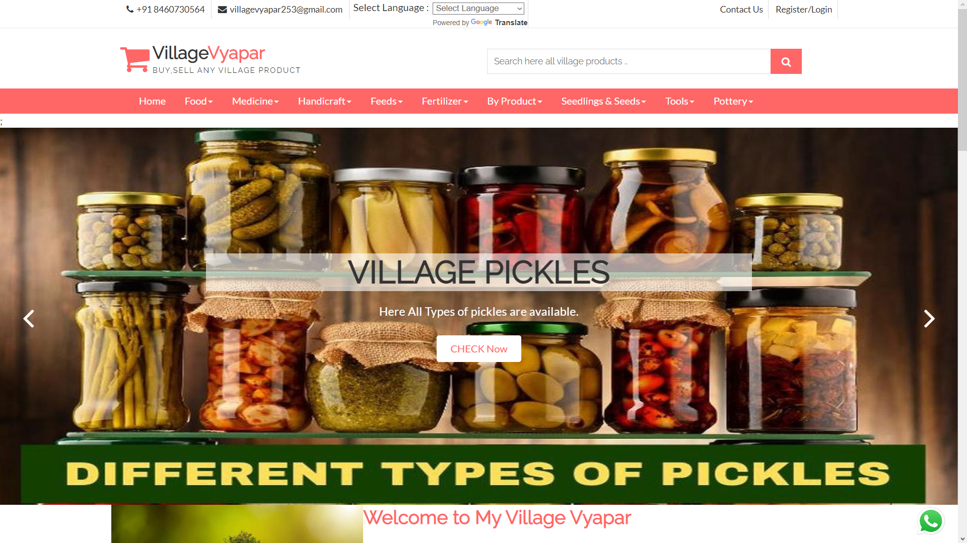
Welcome page

Slide 45
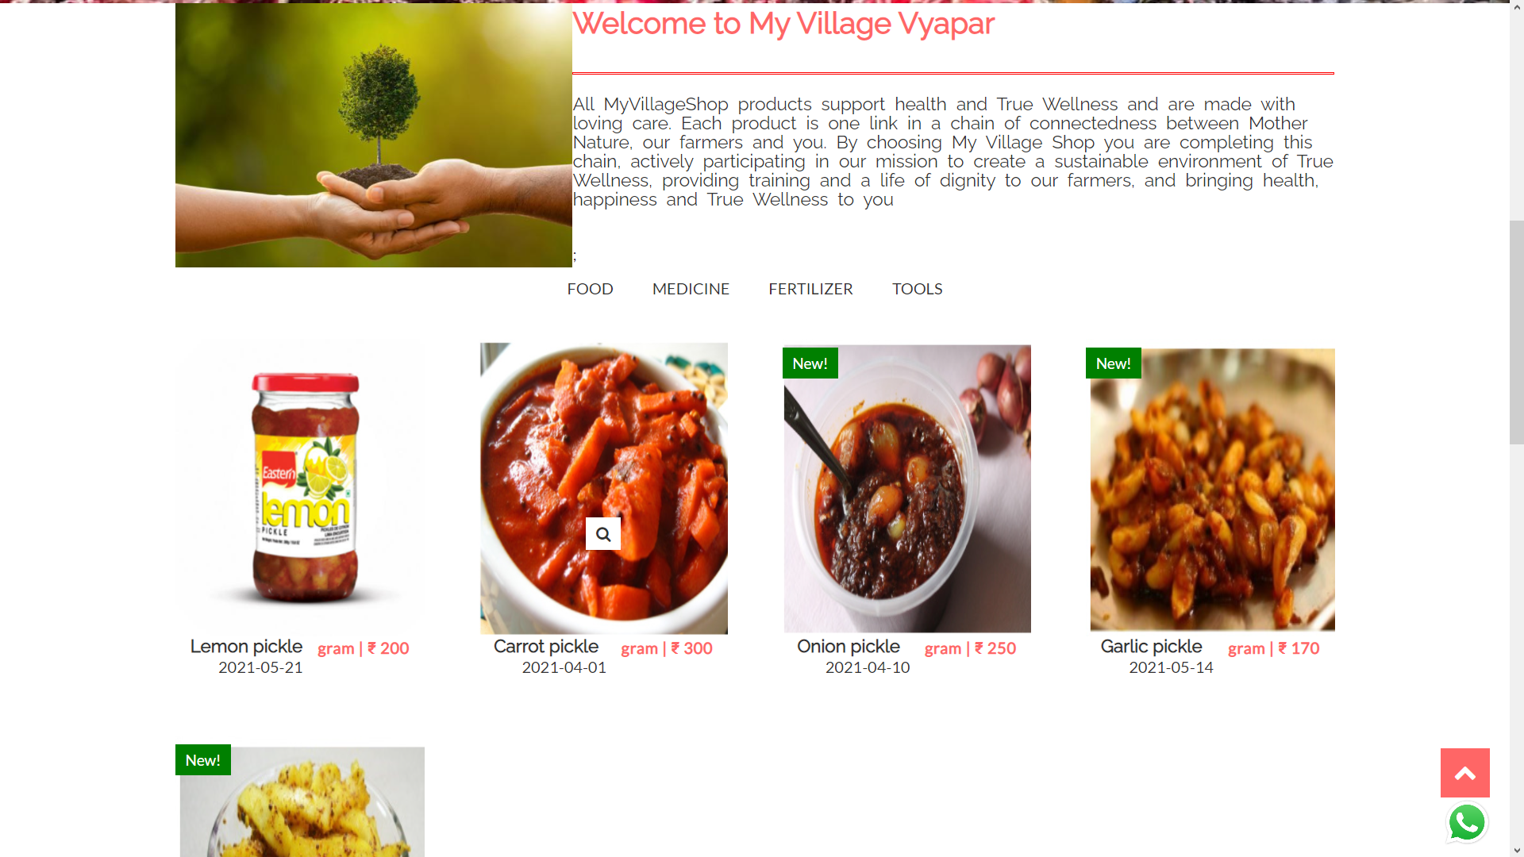
Welcome page

Slide 46
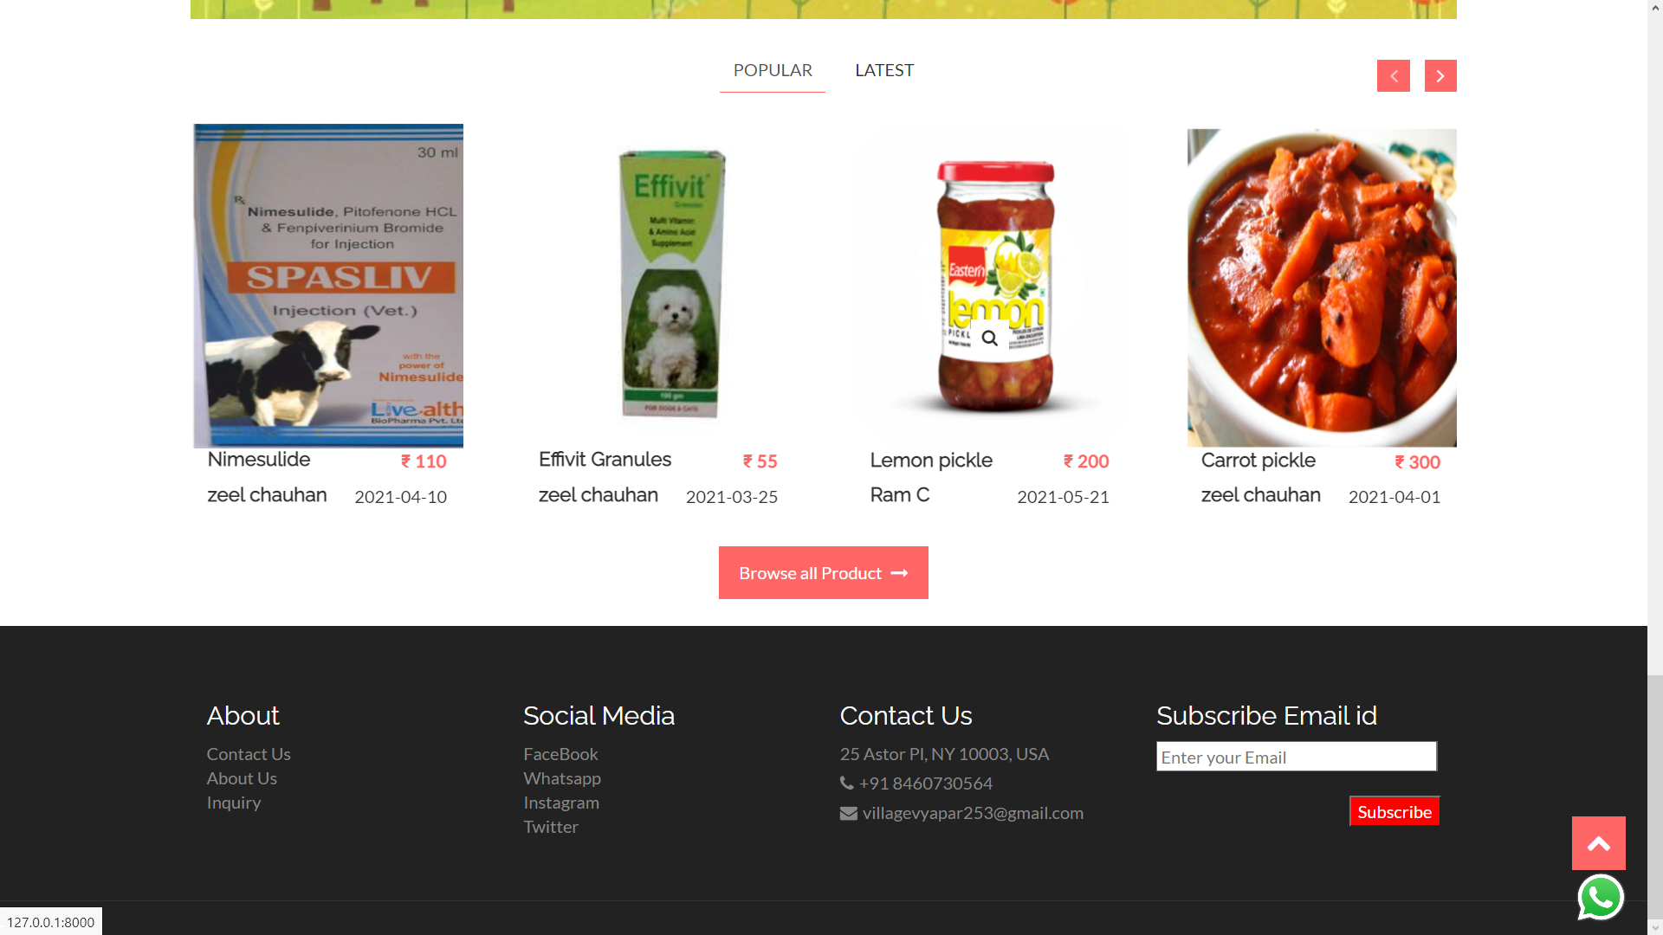
Popular products

Slide 47
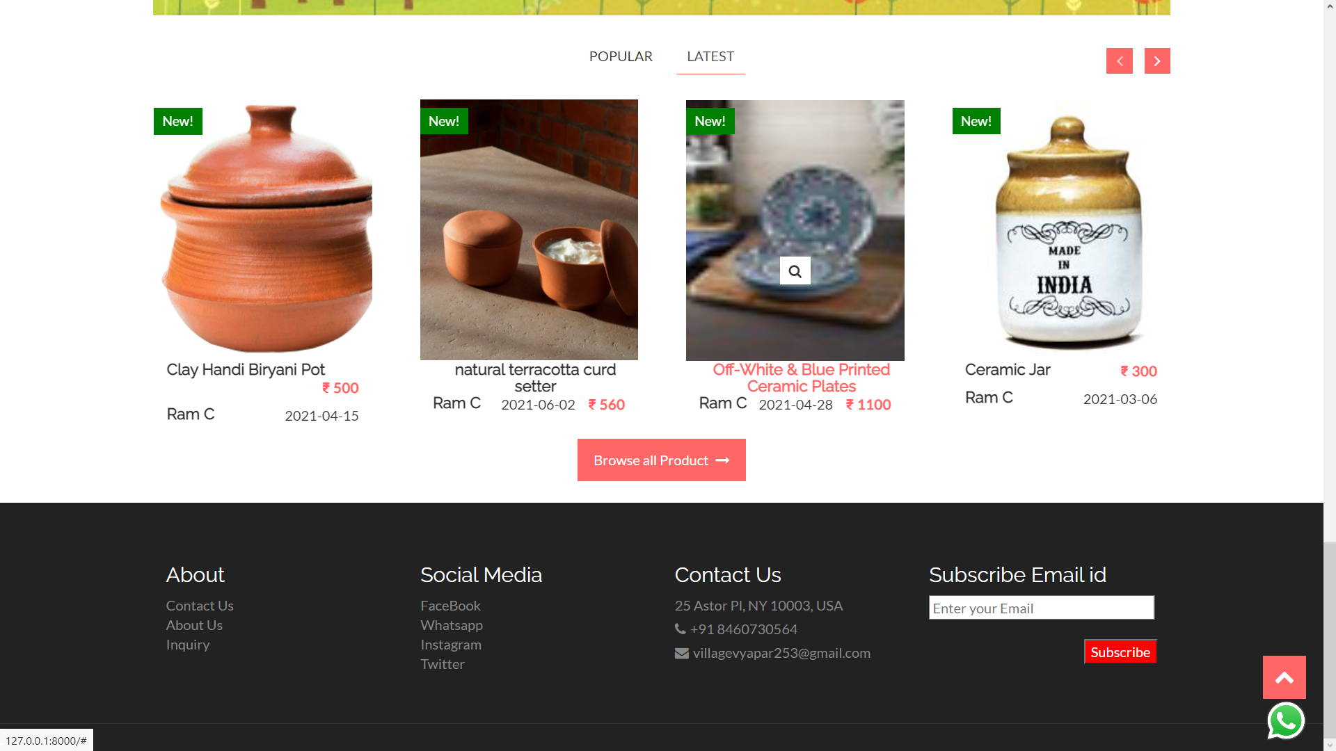
Latest products

Slide 48
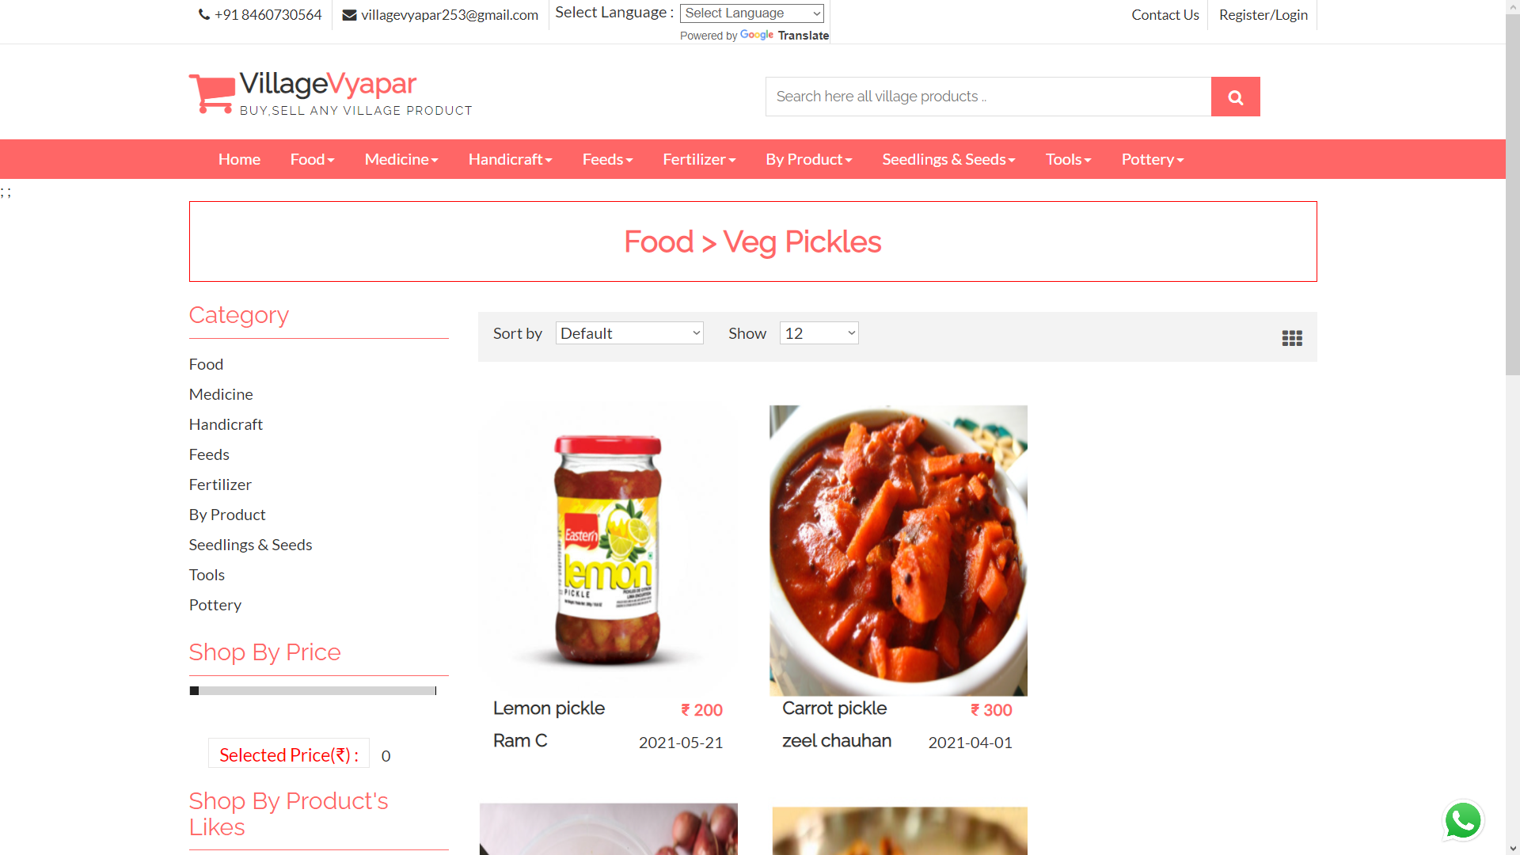
Products within subcategories

Slide 49
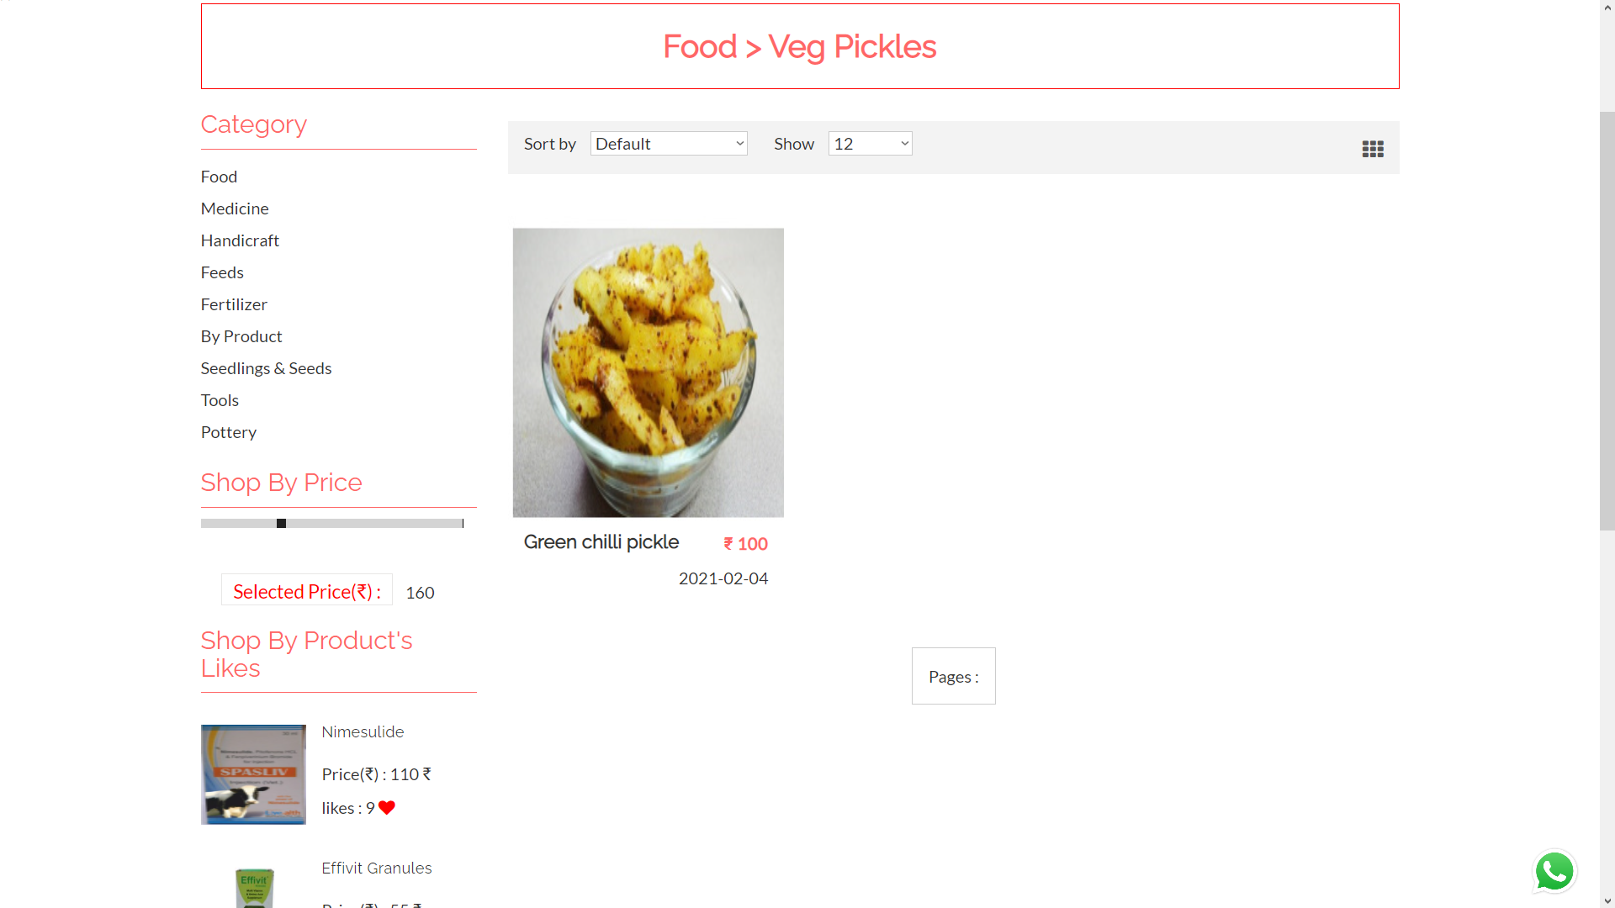
Products limited with price

Slide 50
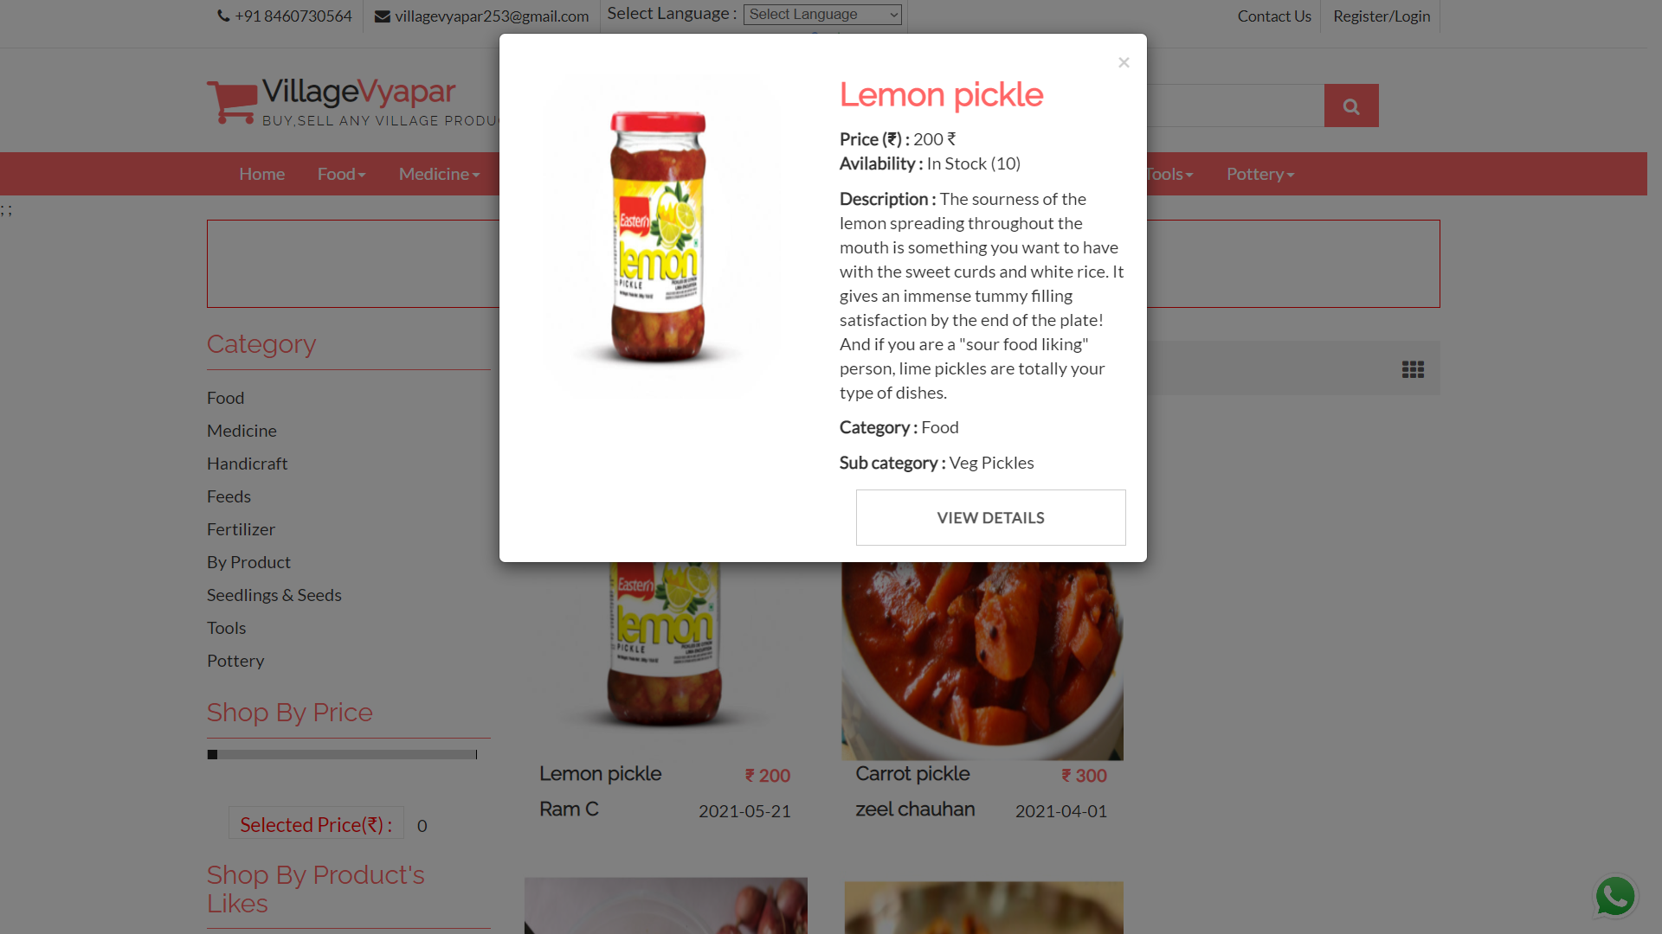
Product details

Slide 51
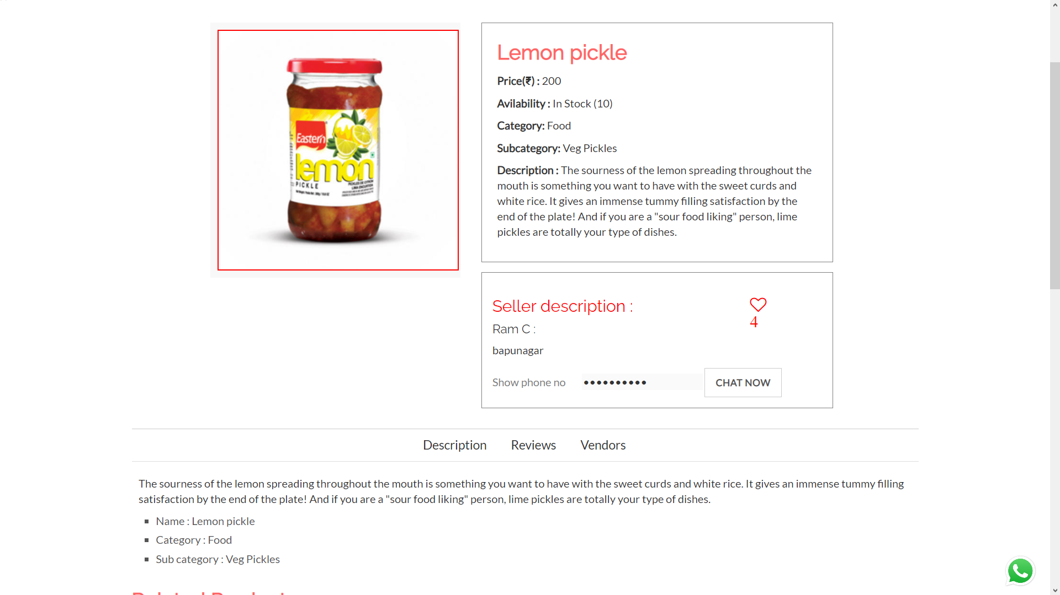
Product details

Slide 52
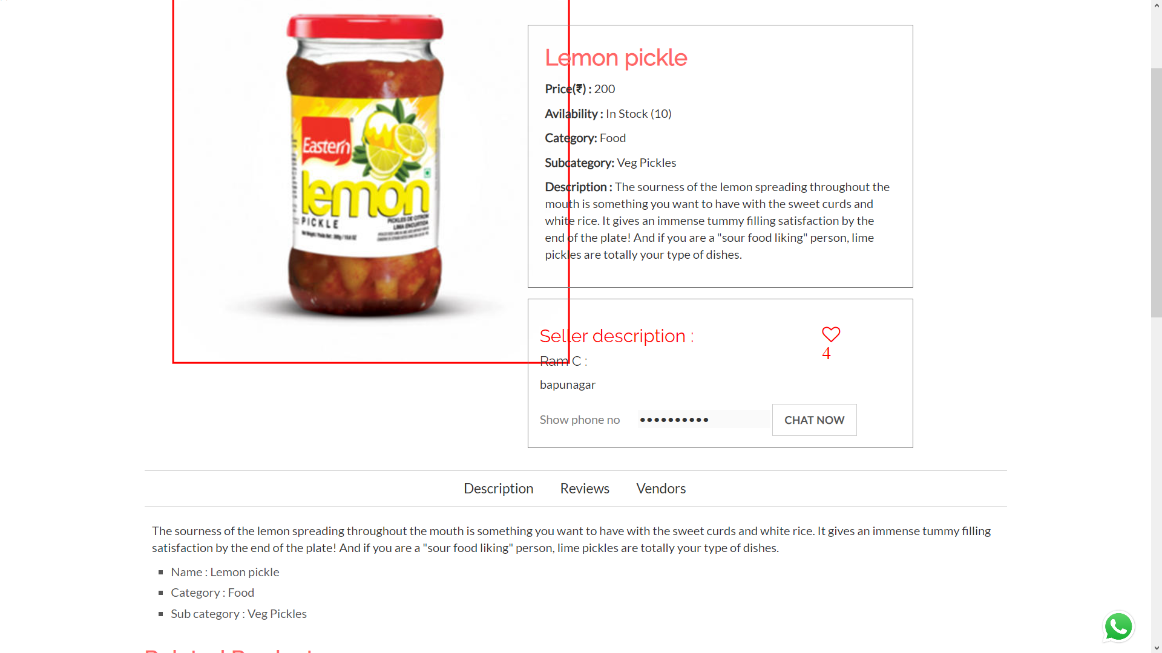
Product image zoomed

Slide 53
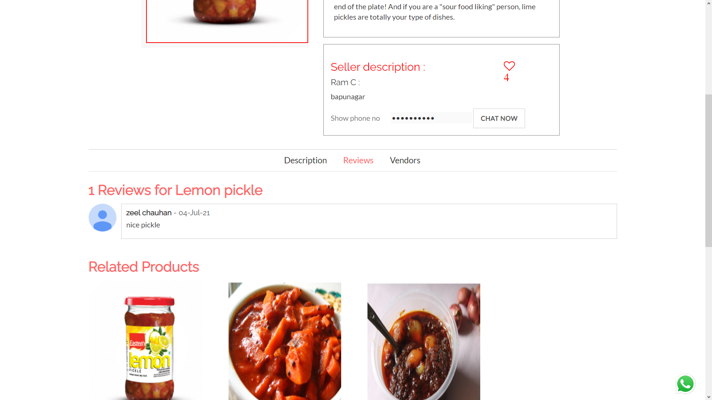
Product review

Slide 54
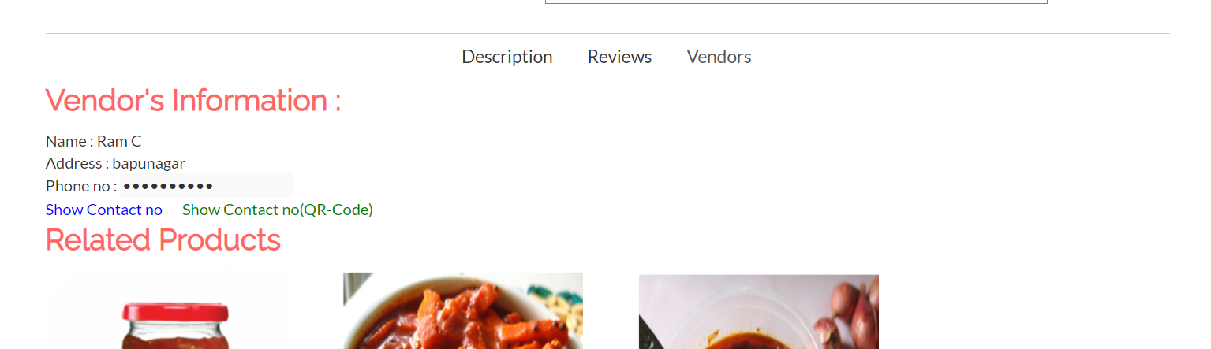
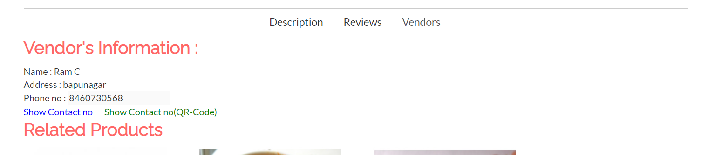
Vendor information

Slide 55
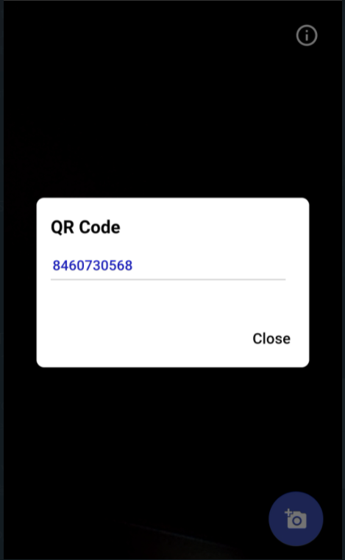
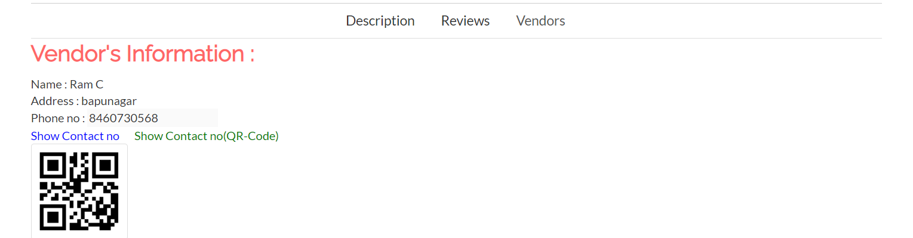
Vendor info 2

Slide 56
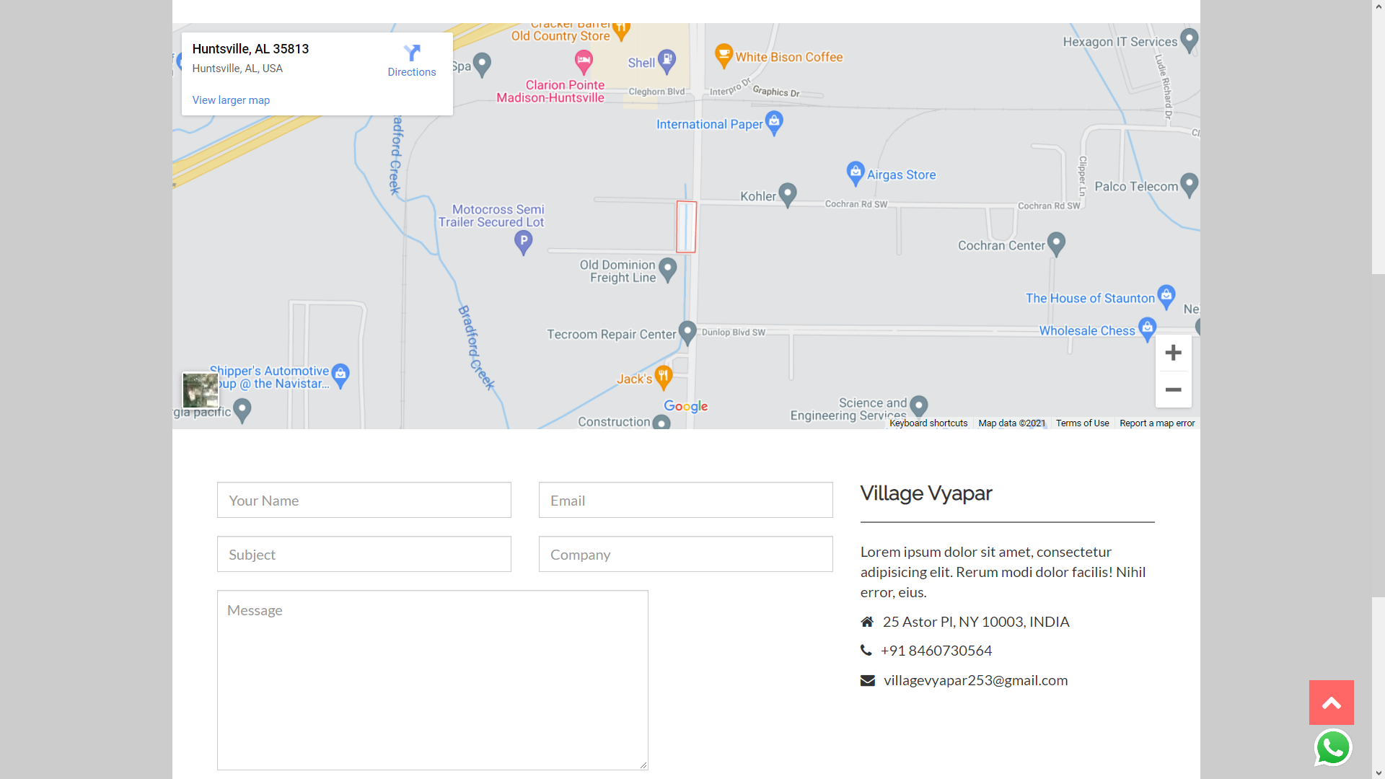
Contact us

Slide 57
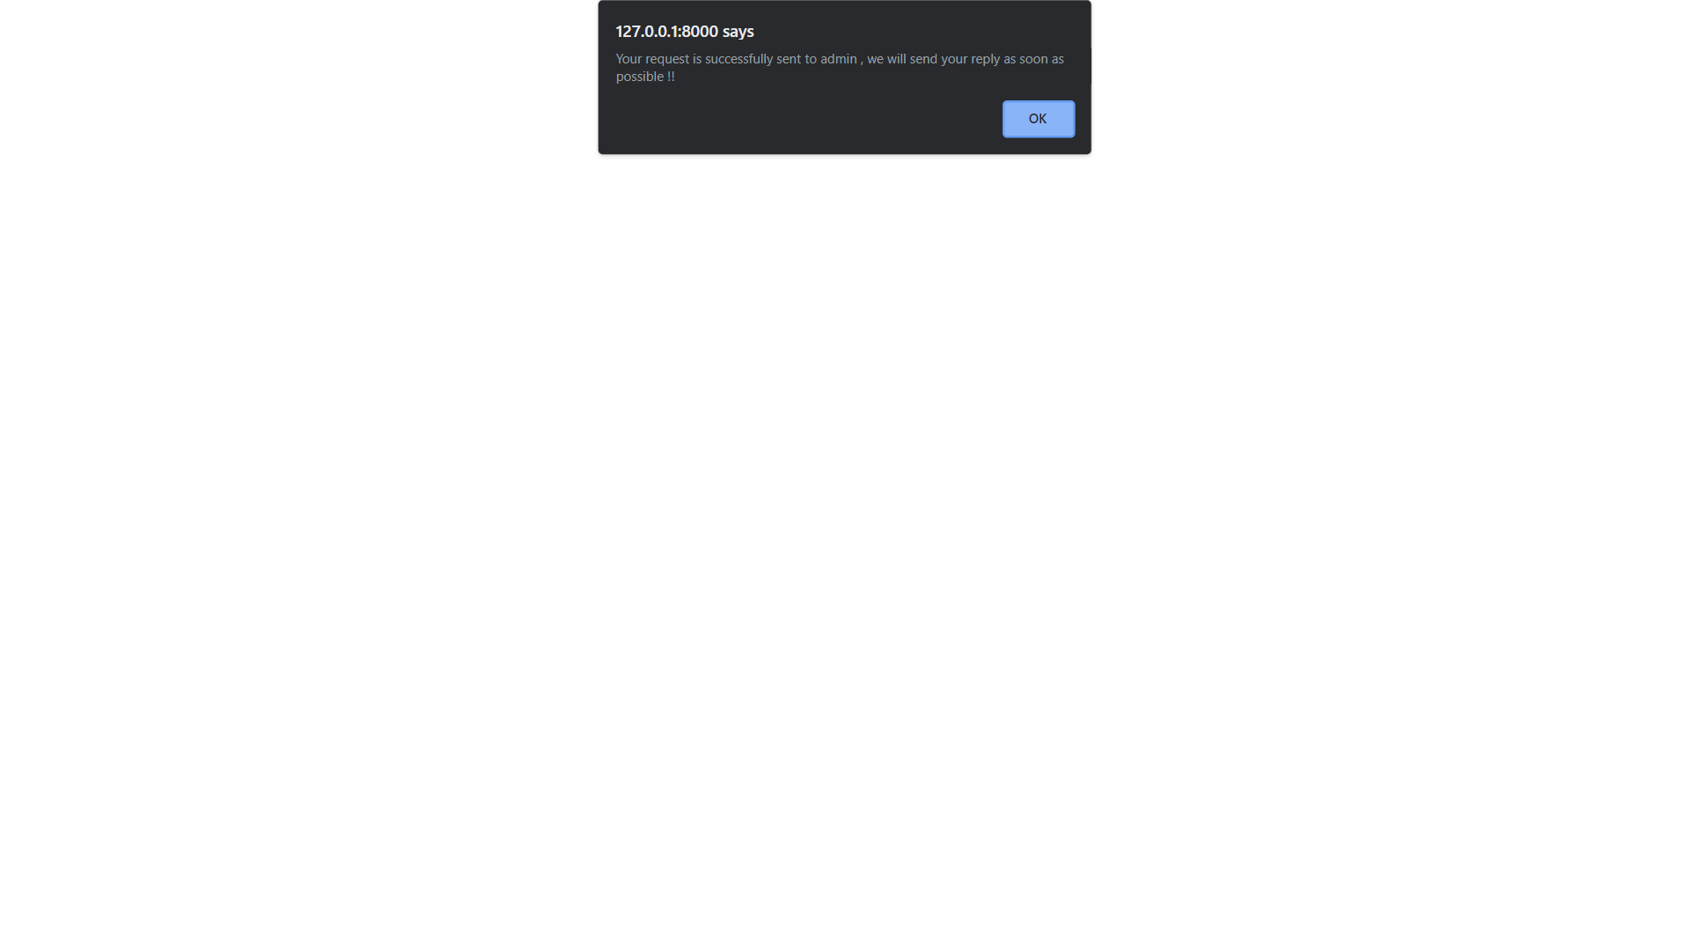
Inquiry

Slide 58
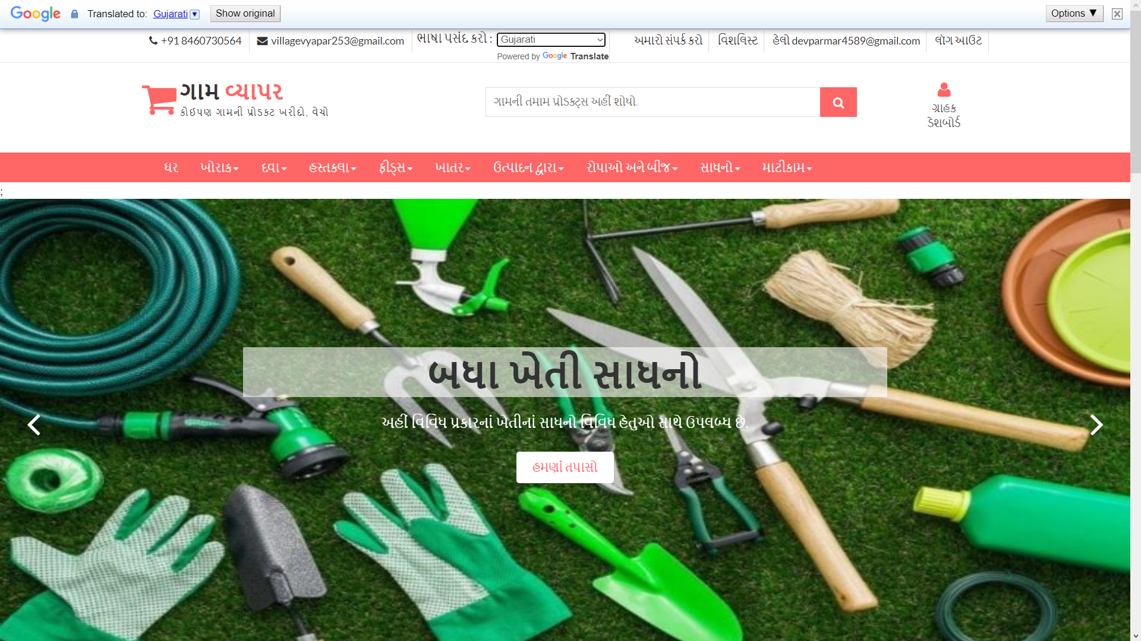
Language changes

Slide 59
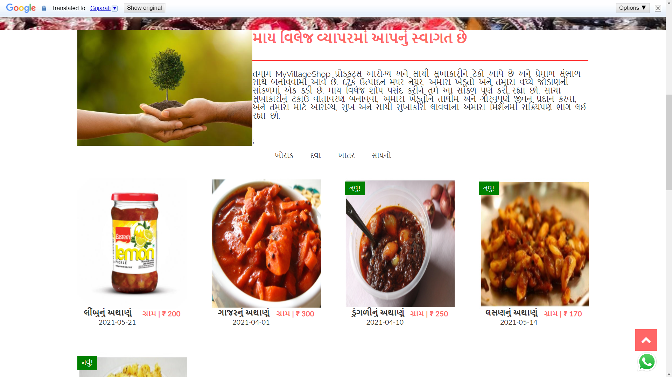
Language changes

Slide 60
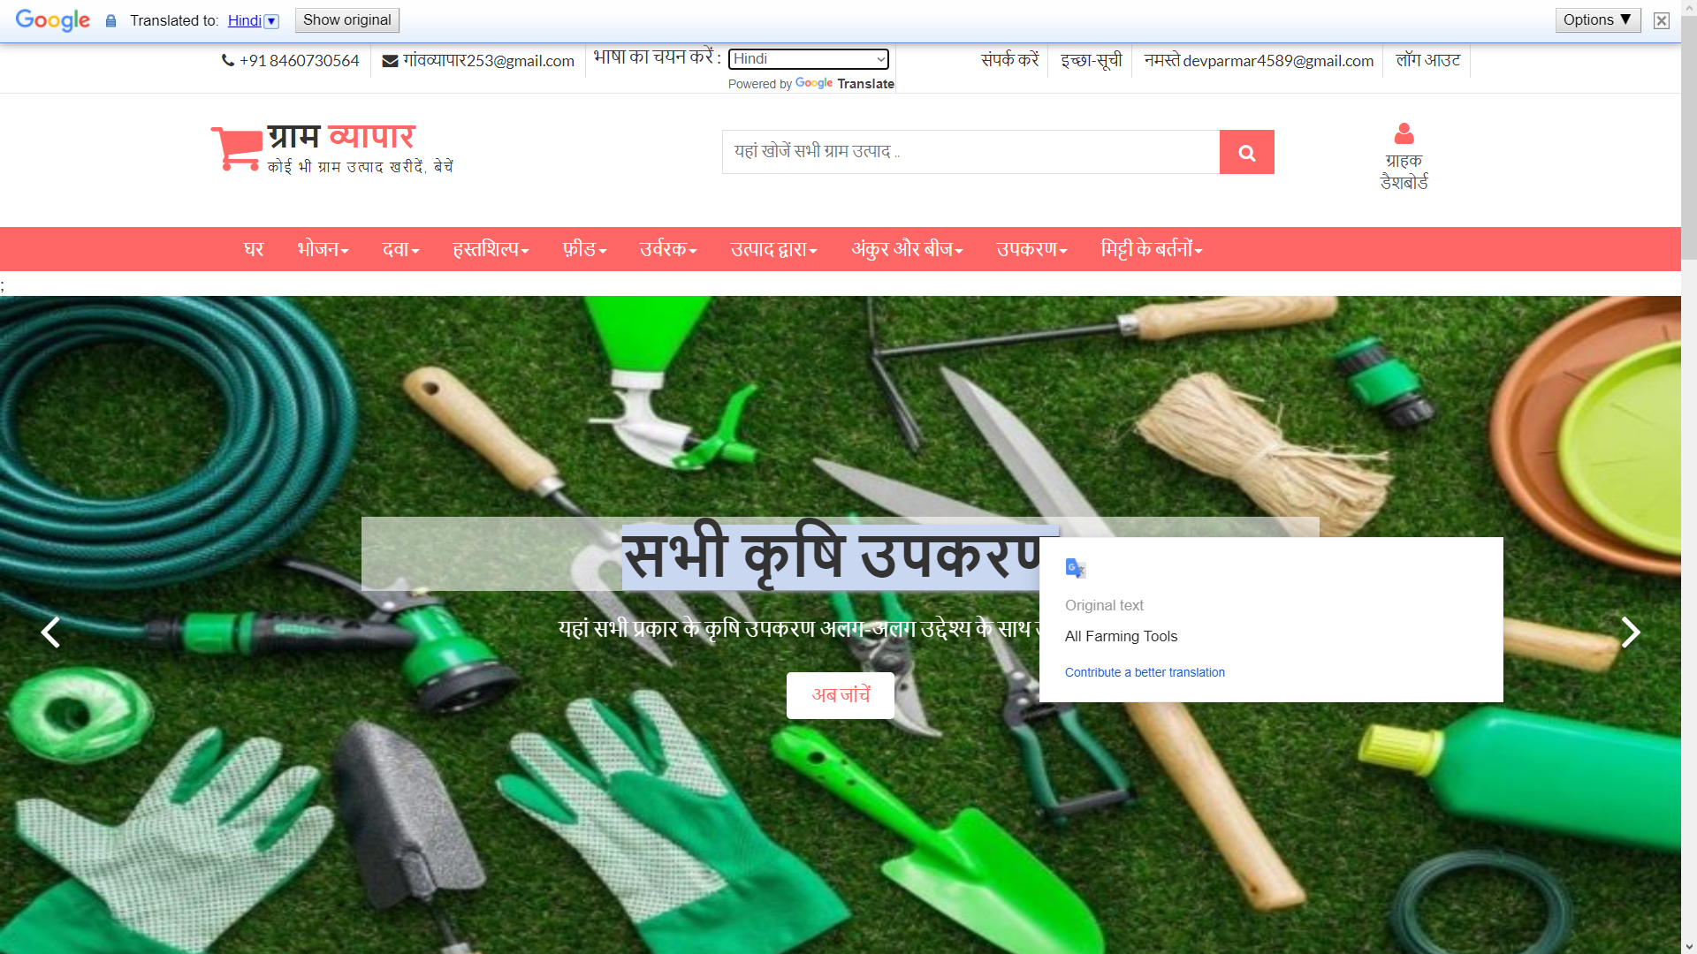
Language changes

Slide 61
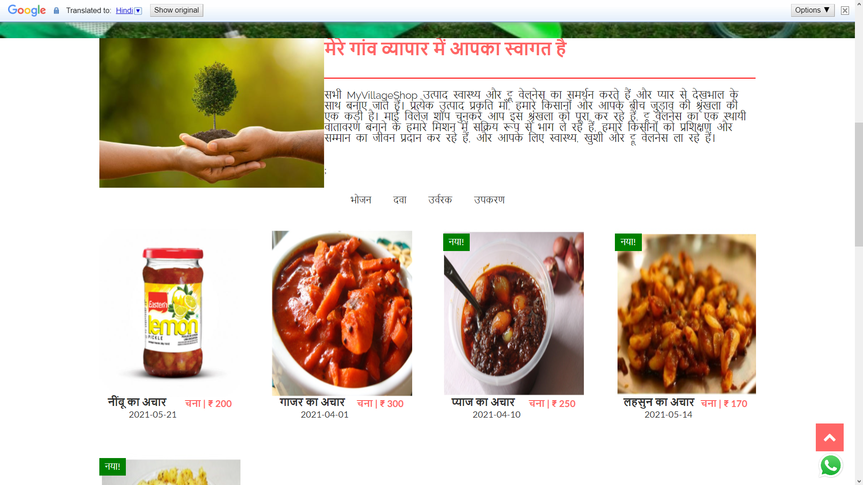
Language changes

Slide 62
Login

Slide 63
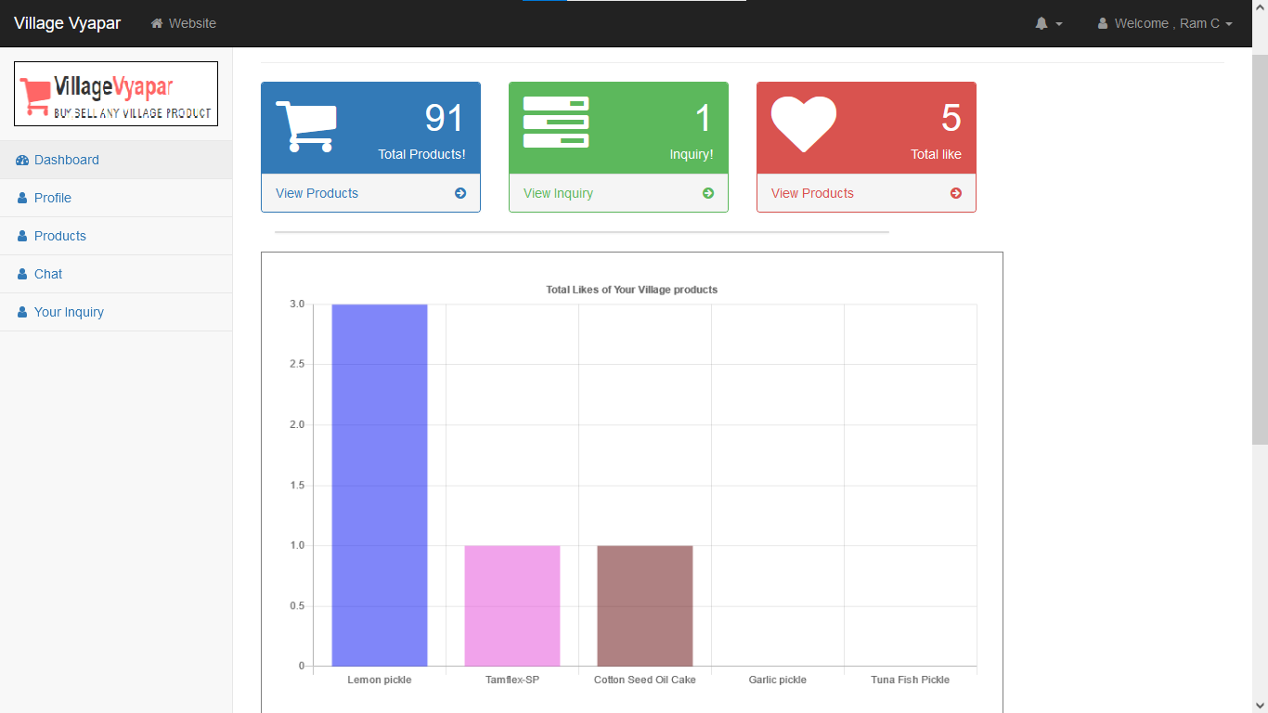
Customer Dashboard

Slide 64
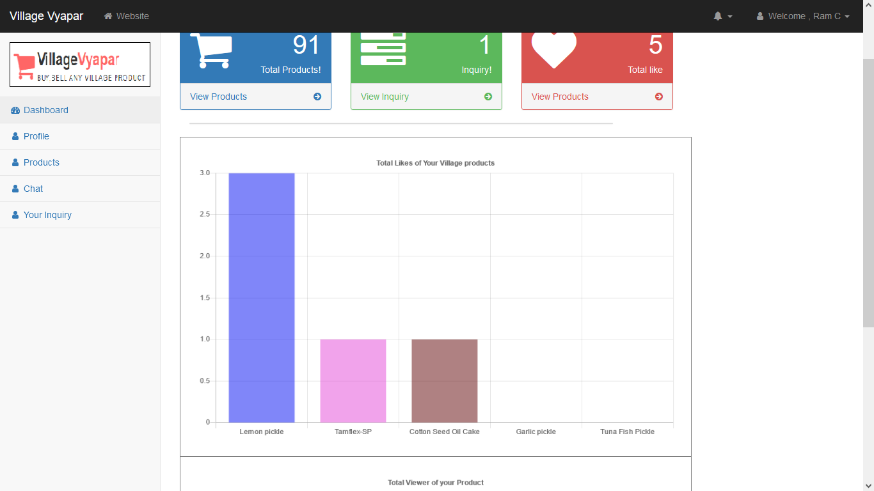
Total Likes of customer products

Slide 65
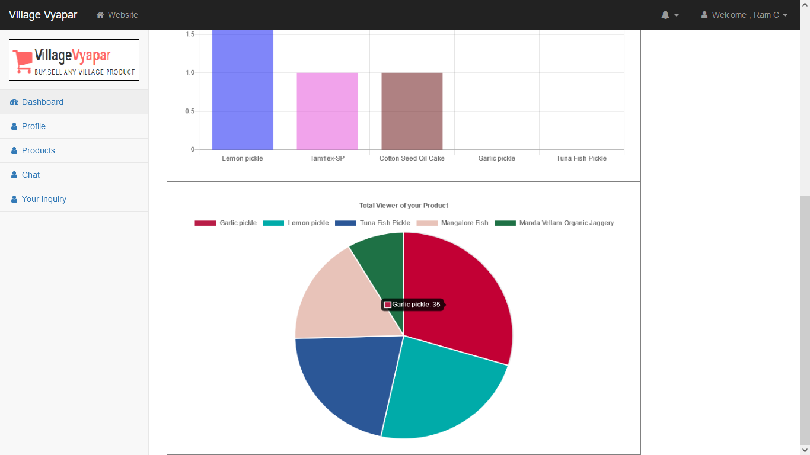
Total Viewer of customer products

Slide 66
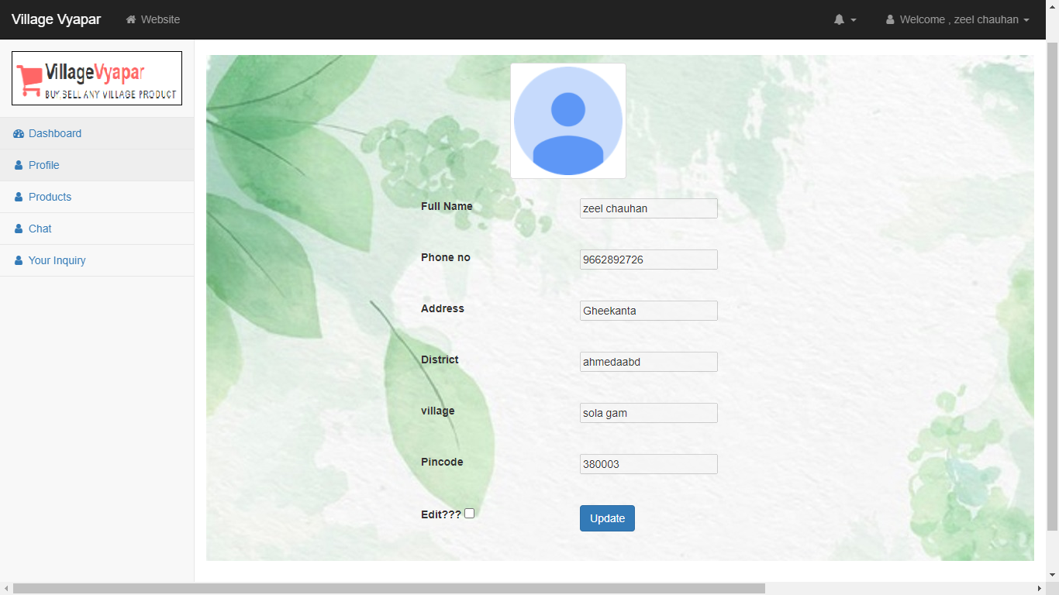
Customer Profile

Slide 67
Update Customer Profile

Slide 68
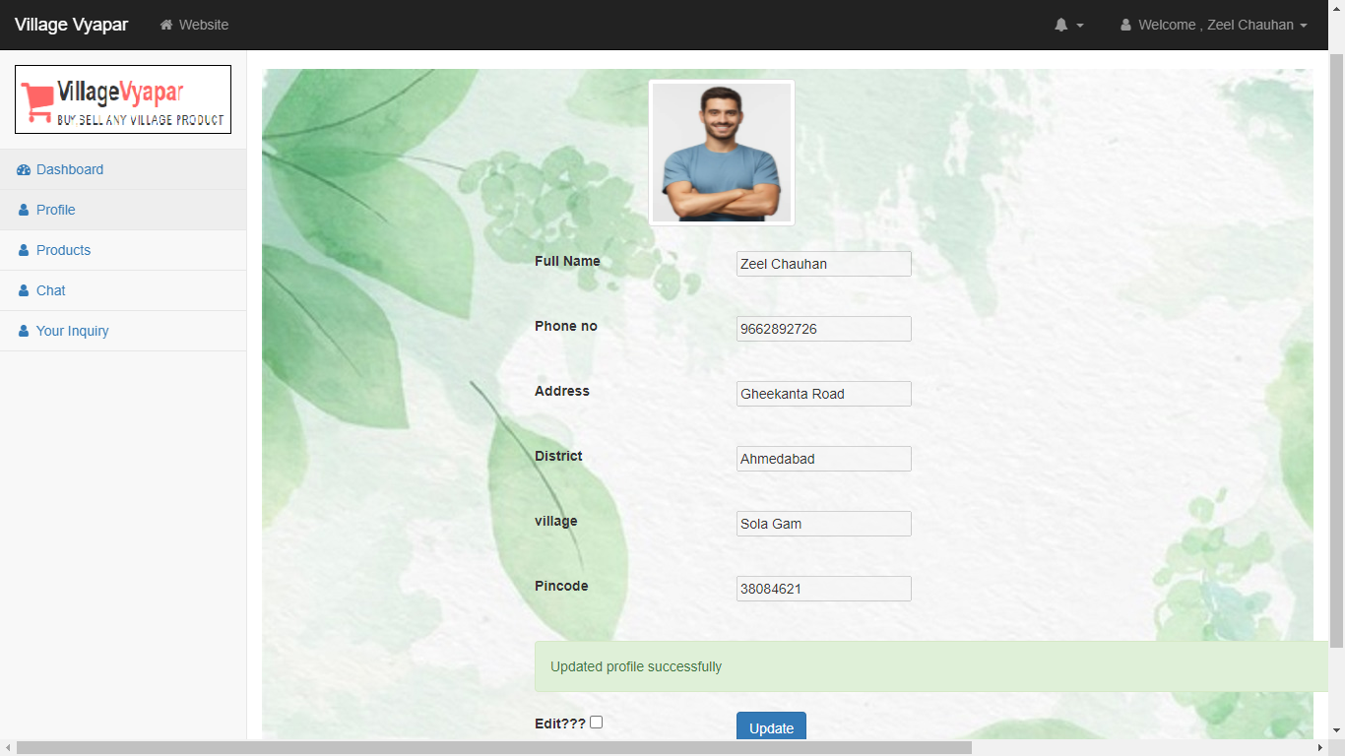

Slide 69
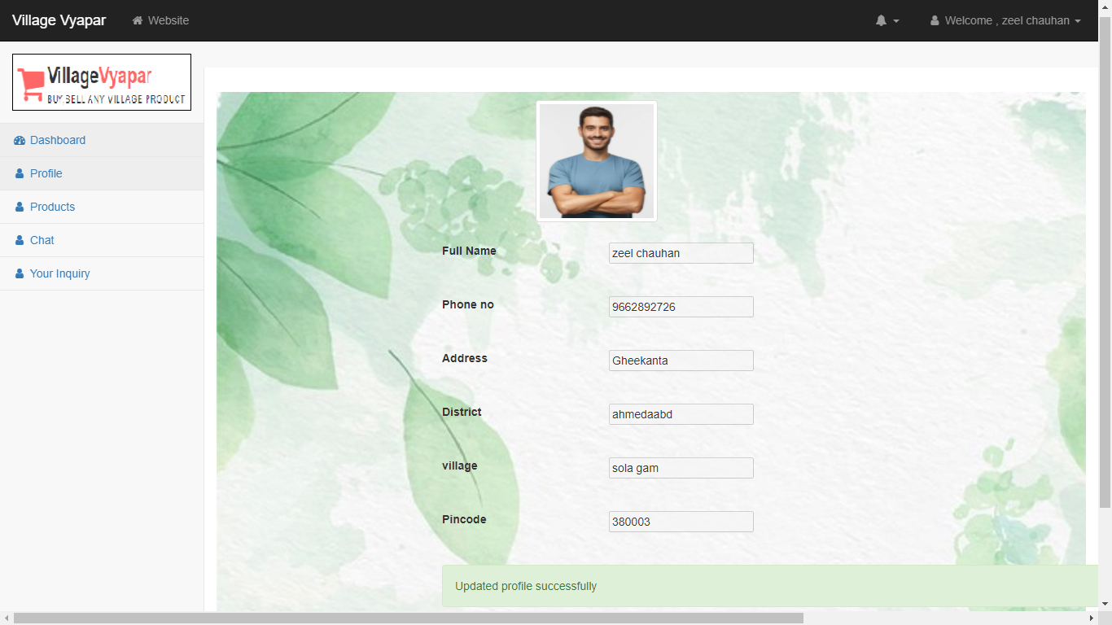

Slide 70
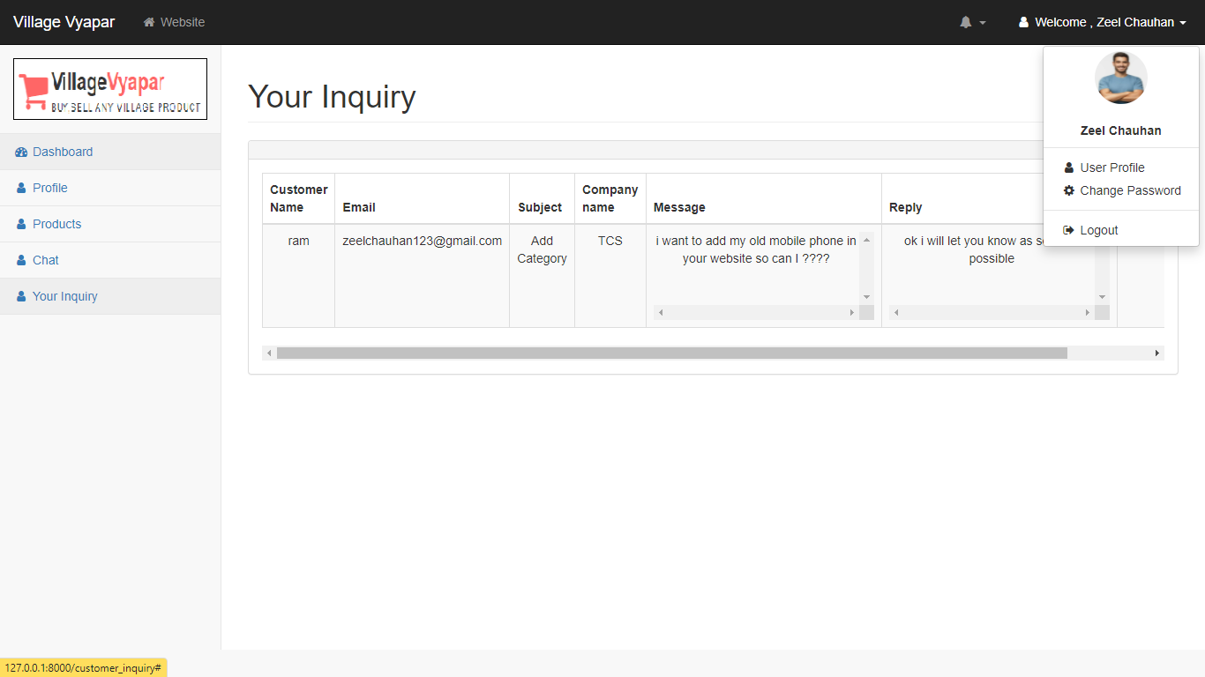

Slide 71
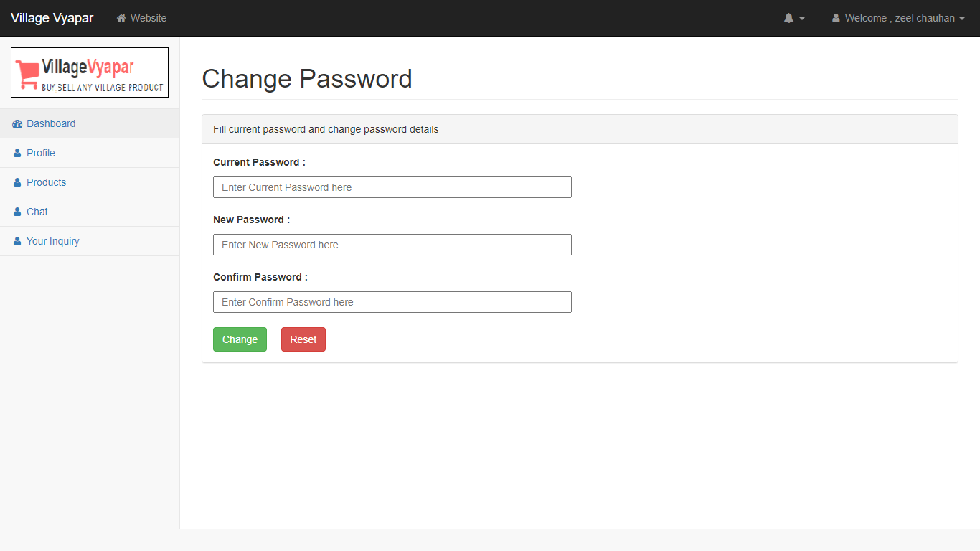
Change Password

Slide 72
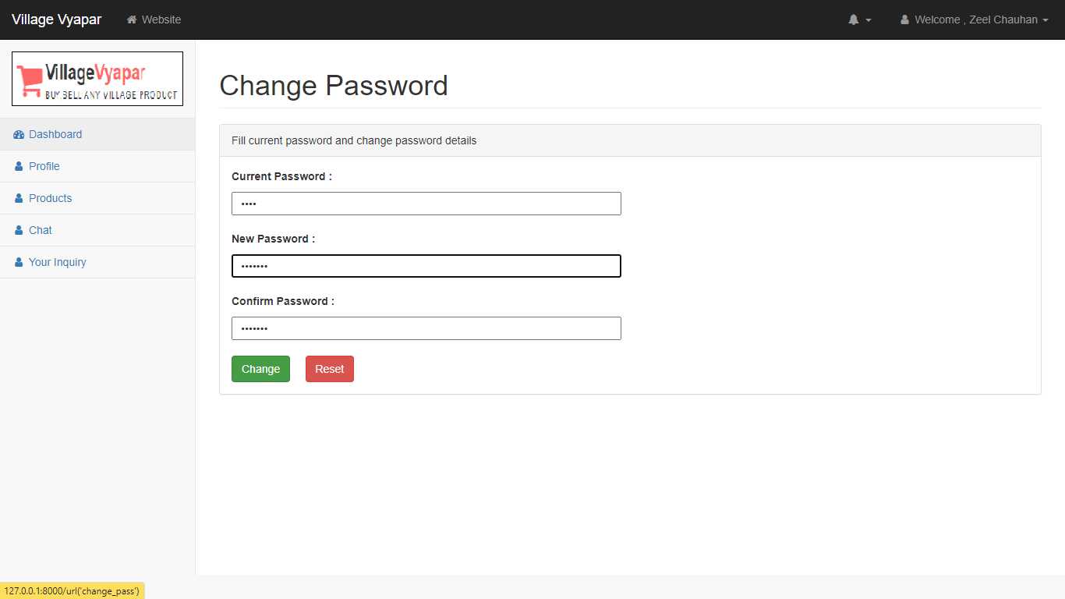

Slide 73
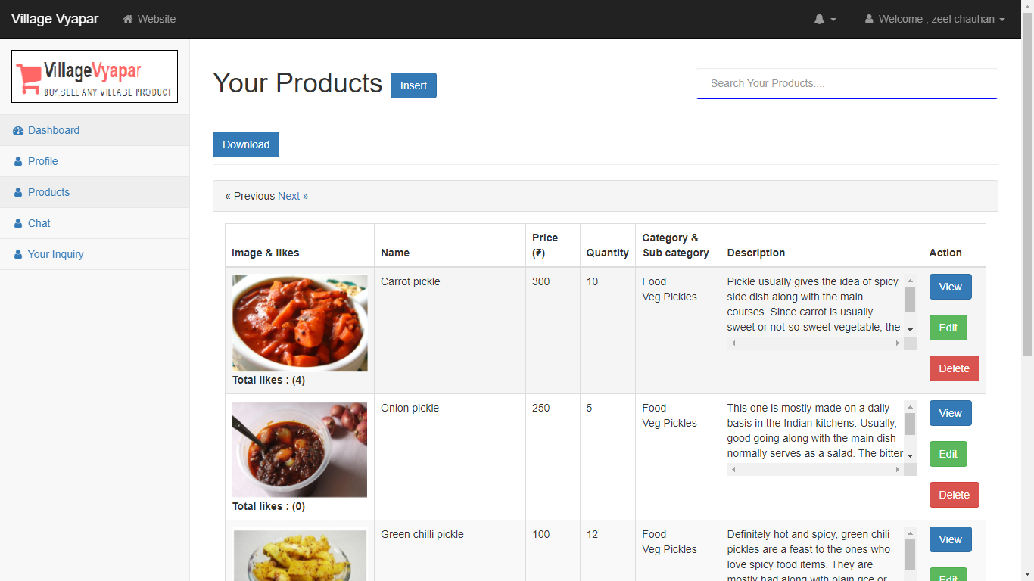
View Products

Slide 74
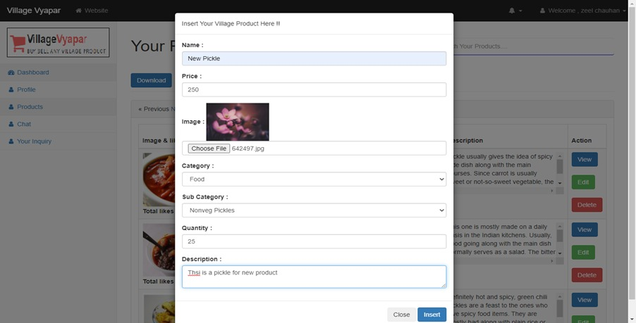
Insert Product

Slide 75
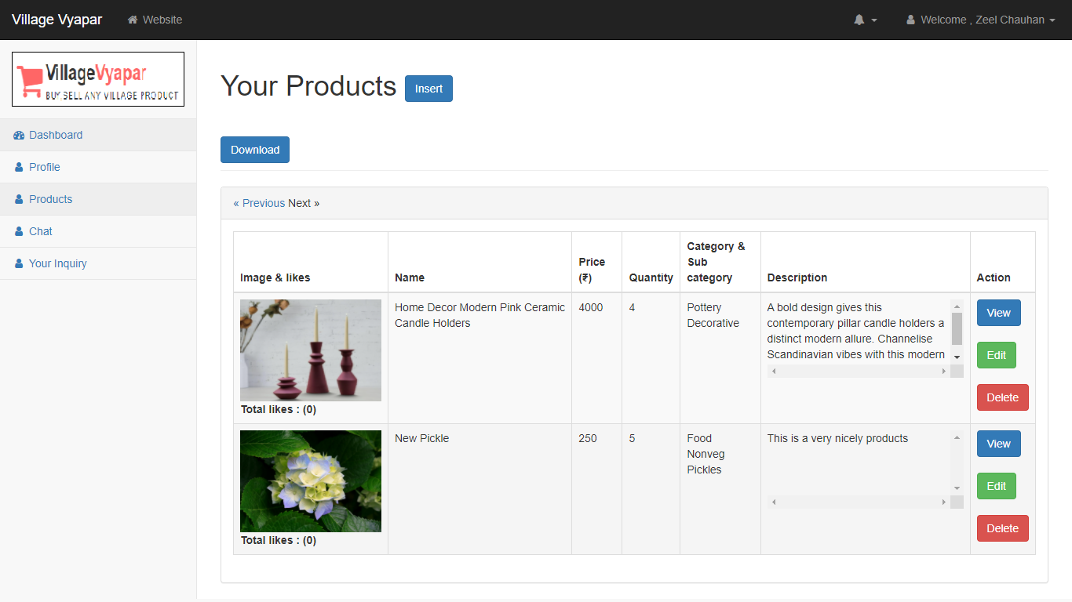
Product Inserted

Slide 76
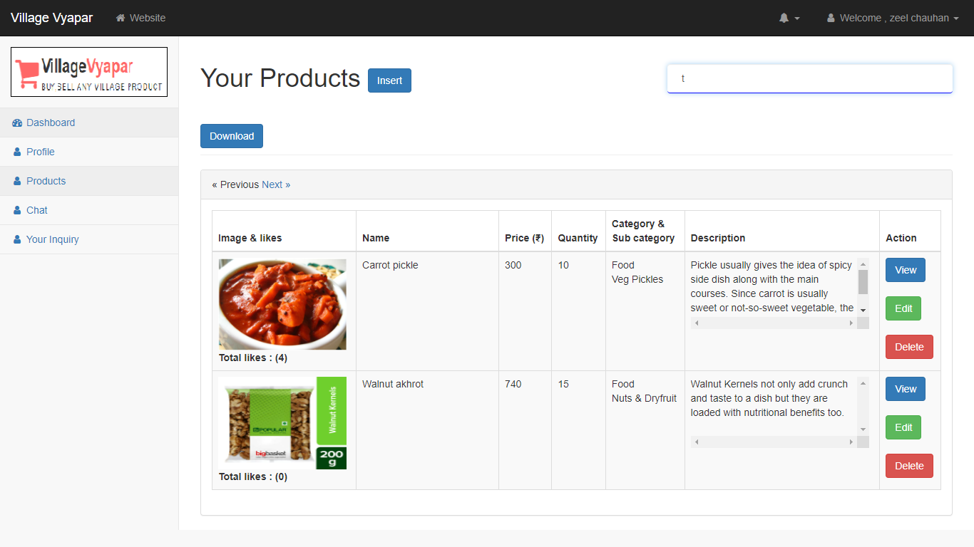
Search Products

Slide 77
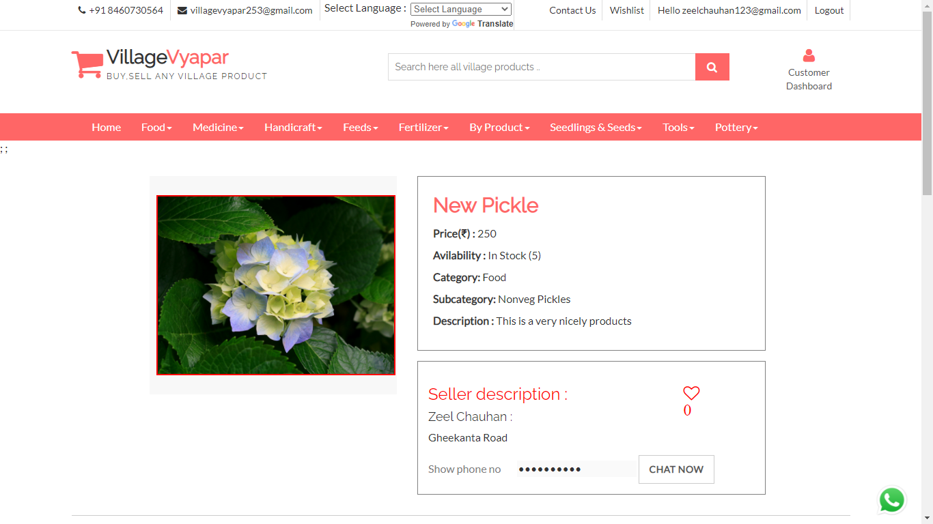
View Product

Slide 78
Edit Product details

Slide 79
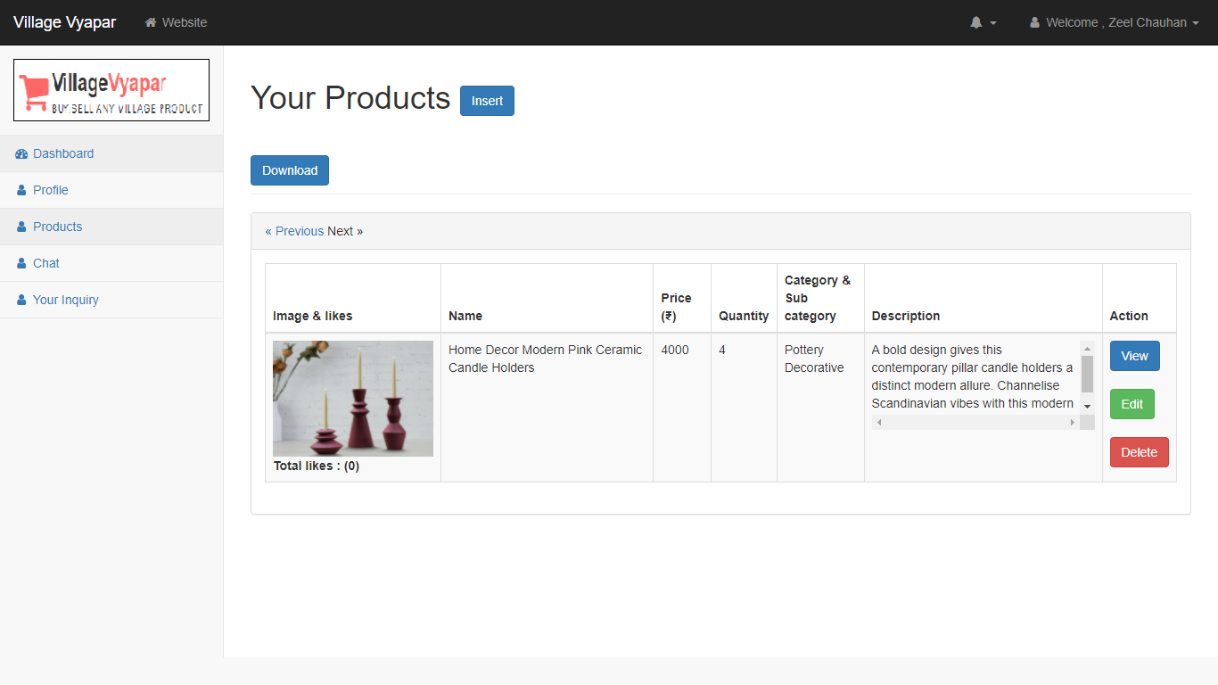
Delete Product

Slide 80
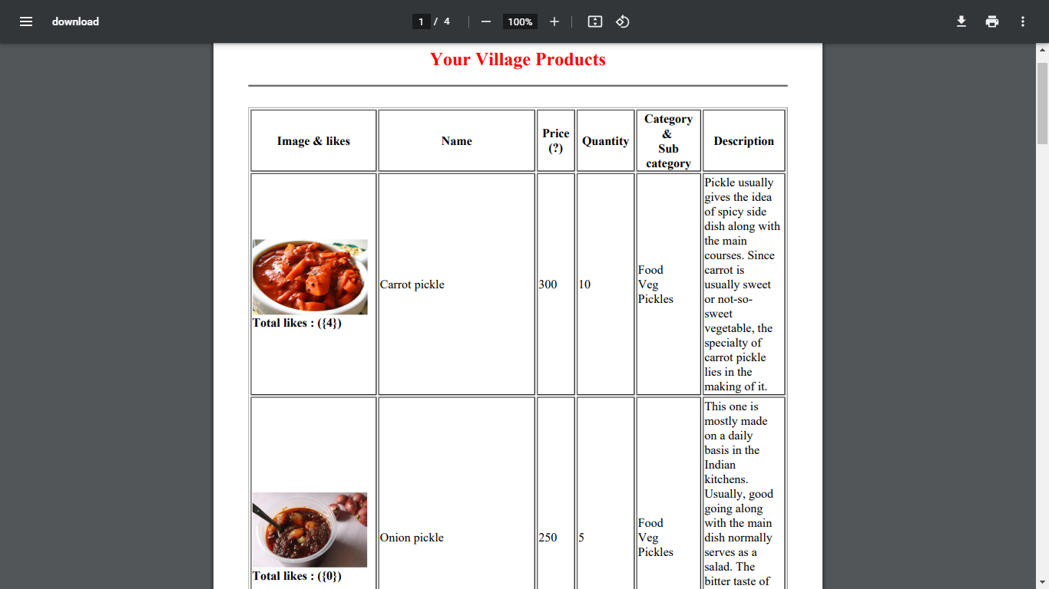
Download Product (Pdf)

Slide 81
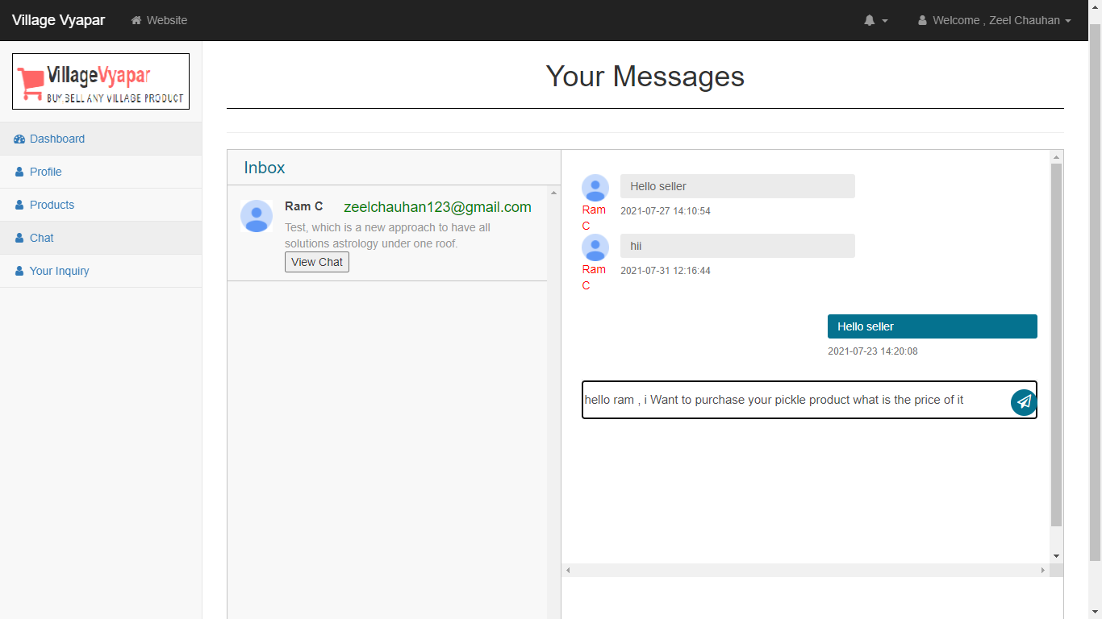
Chat bot

Slide 82


Slide 83

Inquiry

Slide 84

Delete Inquiry

Slide 85


Slide 86
Screen-shots (Admin)

Slide 87

Admin-login Page

Slide 88

Validate Credential

Slide 89

Invalid Login-credential

Slide 90

Admin Dashboard

Slide 91

Show Categories

Slide 92

Add Category

Slide 93

Added New Category

Slide 94

Edit Category

Slide 95

Edit Category

Slide 96

Delete Category

Slide 97

Delete Sample Category

Slide 98

Show Sub-Category

Slide 99

Add Sub-Category

Slide 100

Added New Sub-Category

Slide 101

Delete Sub-Category

Slide 102

Deleted Sub-Category

Slide 103

Shows Products

Slide 104

View Product

Slide 105

Delete Sample Product

Slide 106

Deleted Sample Product

Slide 107

Search Product

Slide 108

View customer list

Slide 109

Search Customer

Slide 110

View Admin list

Slide 111

Show Inquiry

Slide 112

Reply To An inquiry

Slide 113

After Reply To An inquiry

Slide 114

Show Admin Menu

Slide 115

Edit Admin profile

Slide 116

Edited Admin Profile

Slide 117

Admin Forgot Password

Slide 118

Admin Forgot Password

Slide 119

Security Code on Mail

Slide 120

After entering security code and detail

Slide 121

Show Report Menu

Slide 122

Admin Logout

Slide 123
After Logout

Slide 124
3
System Design

Slide 125
Use Case Diagram

Slide 126
Class Diagram

Slide 127
Interaction Diagram

Slide 128
Activity Diagram

Slide 129
Data Dictionary

Slide 130
5
Proposed Enhancement

Slide 131
6
Conclusion

Slide 132
7
Bibliography

Slide 133
THANK YOU
Group No : 04

